Slide 1
Filtering Approaches for Real-Time Anti-Aliasing
http://www.iryoku.com/aacourse/

Slide 2
Filtering Approaches for Real-Time Anti-Aliasing A Directionally Adaptive Edge Anti-Aliasing Filter
Jason Yang
jasonc.yang@amd.com

Slide 3
Current Hardware Approach: Multisample Anti-Aliasing (MSAA)
No AA
Notes:
Stair stepping

Slide 4
Current Hardware Approach: Multisample Anti-Aliasing (MSAA)
Color gradations limited by the number of hardware samples
8x AA
Notes:
In this example at most 8 gradations (not including no coverage).

Slide 5
MSAA Overview
Estimate primitive pixel coverage by testing at sample points
Calculate a single color value per pixel per primitive (usually at the center of the pixel or at the centroid of the covered samples) and assign it to all covered samples
Notes:
This pixel is considered ¾ filled by primitive even though it’s about ½ filled
4 samples at most 4 levels of gradation (5 including non covered)

Slide 6
Traditional MSAA
Speeds up rendering by not calculating values for each sample separately
Non-uniform sampling grid is used to improve pixel coverage estimate

Slide 7
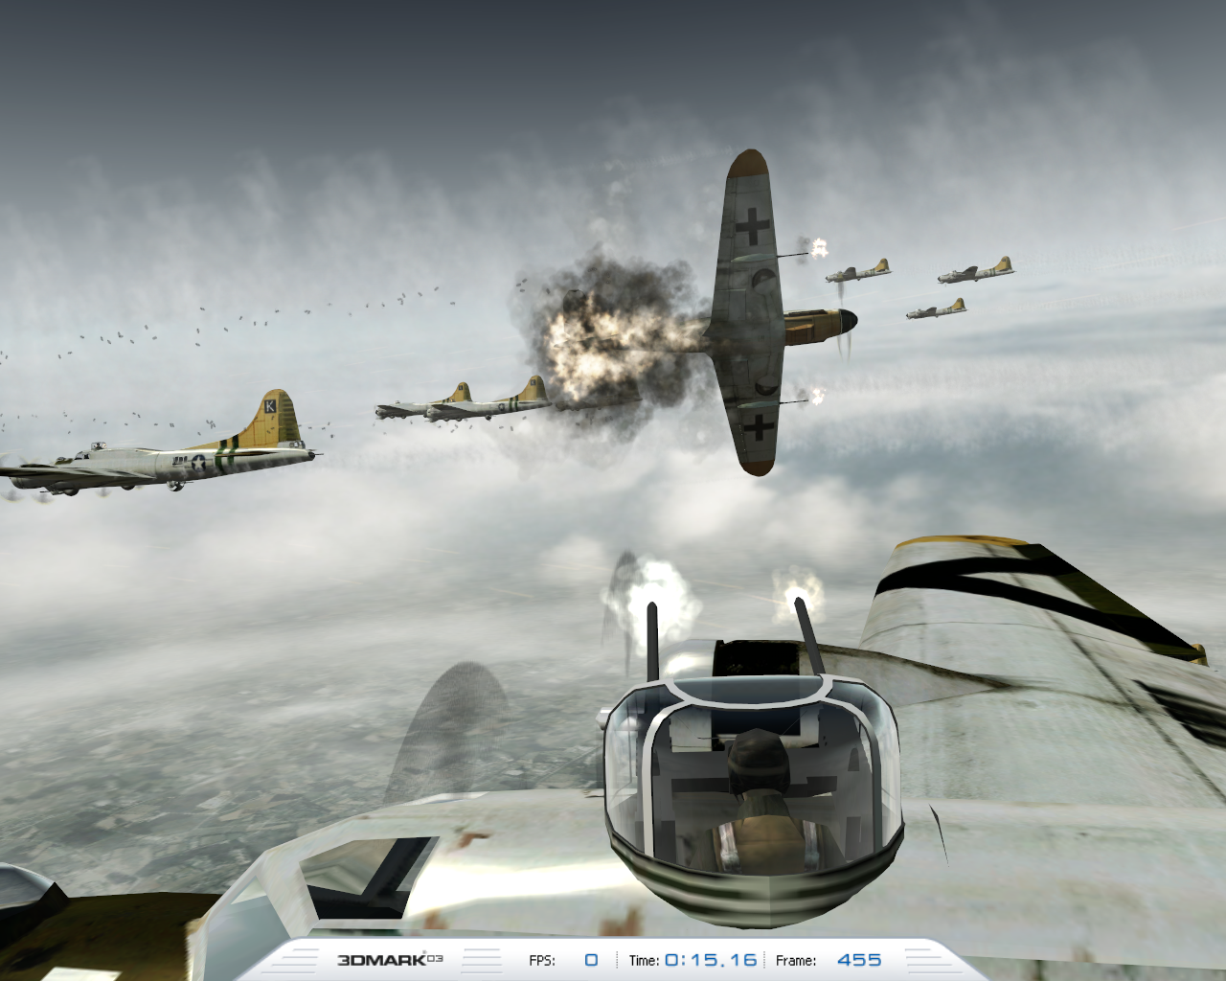
Traditional MSAA
Primary goal is anti-aliasing of primitive and Z edges
Notes:
HWAA only deals with geometry edges, not textures.

Slide 8
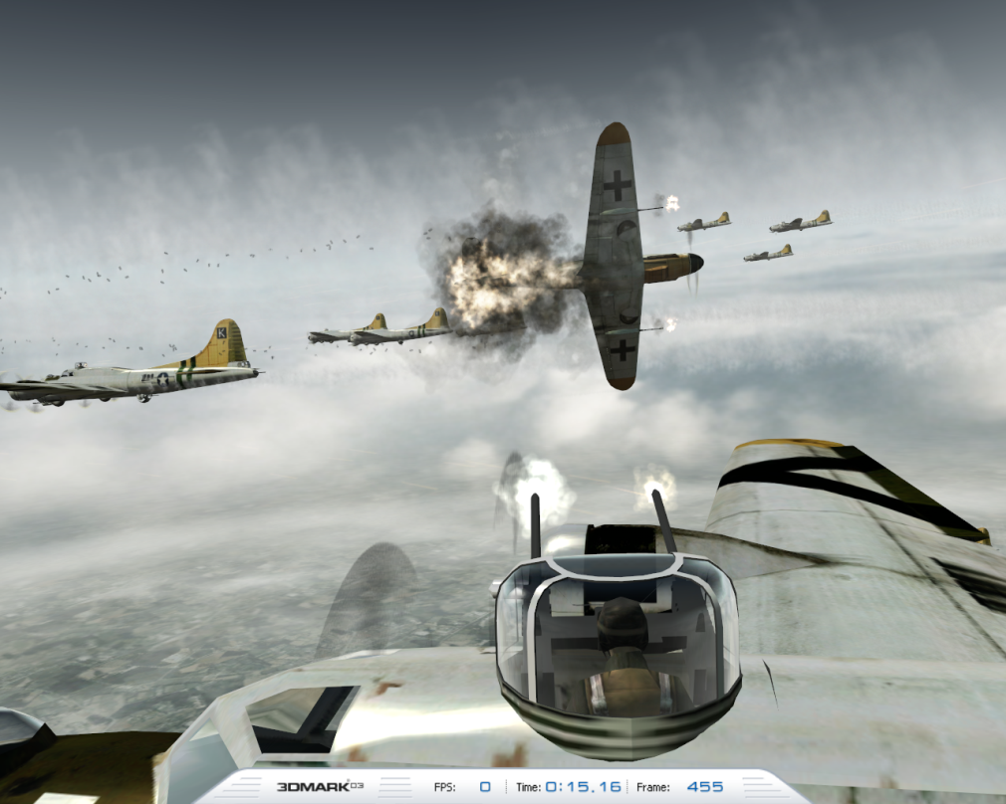
Traditional MSAA
Texture resampling performed elsewhere (mipmapping)
High frequency texture details (e.g. text) are lost in the MSAA color buffer and cannot be easily post-processed further

Slide 9
Motivation
Can we use the GPU’s shader processing power and flexibility for better edge anti-aliasing (AA)?
Goal
Improve primitive edge appearance (vs. “standard” MSAA processing) using the same number of samples and better software filtering algorithms

Slide 10
Motivation
Can we use the GPU’s shader processing power and flexibility for better edge anti-aliasing (AA)?
Our New Filter
Notes:
Edge-Detect Custom Filter AA – using 8x MSAA coverage samples can achieve up to 24 gradations of color.

Slide 11
Key Insight: Integration Approach and Isolines
If we know isolines (isophotes) of the image function
Sample values outside of the pixel can be used
Weight them by the length of the corresponding isoline segment in the pixel and add all of them
Notes:
If there’s an edge there will be isolines, so can use samples outside of the pixel.

Slide 12
Isoline Evaluation in Three Channels
Need to find isolines
But only in the case of low curvature (as this is the case near the actual primitive edges)
Then we can model them as a straight lines
Fit a plane into three channels to compute a gradient estimate
Use linear approximation
Solve least squares problem
Please see [Iourcha HPG2009] for more details
Notes:
Effectively doing a linear fit of the RGB samples – least squares problem.
Iourcha, K., Yang, J., and Pomianowski, A. 2009. A Directionally Adaptive Edge Anti-Aliasing Filter. High Performance Graphics.

Slide 13
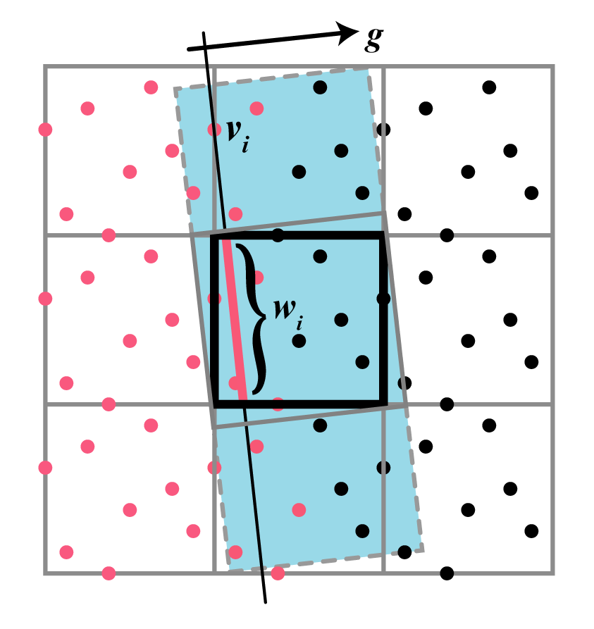
Filter Computation (Integration)
Construct a square around the pixel, with two sides orthogonal to g
Extend the rectangle, in the direction orthogonal to g until it meets the 3x3 pixel boundary

Slide 14
Filter Computation (Integration)
For every sample v_{i}, length of the segment of the line passing though v_{i} and orthogonal to g inscribed by the pixel is its weight w_{i}
Calculate the weighted sum of all samples in the rectangle

Slide 15
Bringing It All Together: Sample Implementation
Implemented using MS DirectX 10.1
Four shader passes:
Input from rendering
MSAA Buffer
Pass 3
Pass 1
Gradient Calc.
Gradient Buffer
Resolve
Pass 2
Pass 4
Edge Finding
Edge Buffer
Masking
Depth Buffer
Integration
Frame Buffer
Display

Slide 16
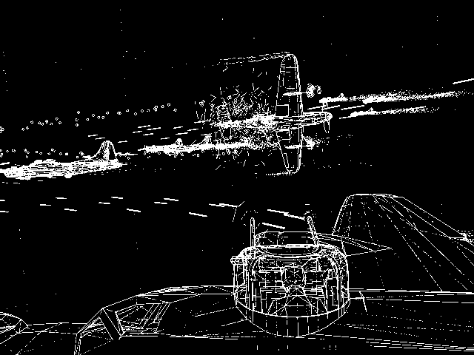
Pass 1
Identify edge pixels using the MSAA buffer.
Partial coverage == edge
High color contrast == edge of interest
Seed the frame buffer by performing a standard resolve at each pixel
Notes:
You know there’s an edge of the samples are not fully covered.

Slide 17
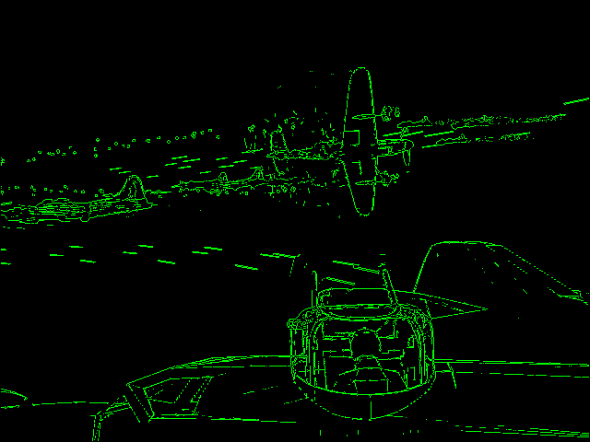
Pass 2
Mask out candidate pixels using edge patterns
Computed in shader vs. tables
We use 3x3 pixel patterns
Notes:
Notice elimination of pixels from masking

Slide 18
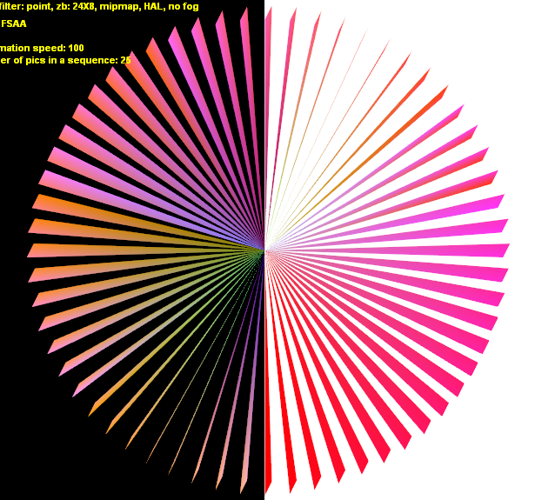
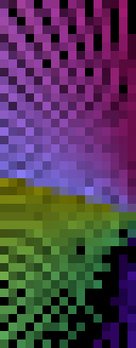
Masking
For instance, if all 3x3 pixels are “edge” ones, there is no long dominating edge, and we do not want to smooth-out high-frequency in this case, etc.
Notes:
Aids in performance and look. Don’t want to overfilter corners.

Slide 19
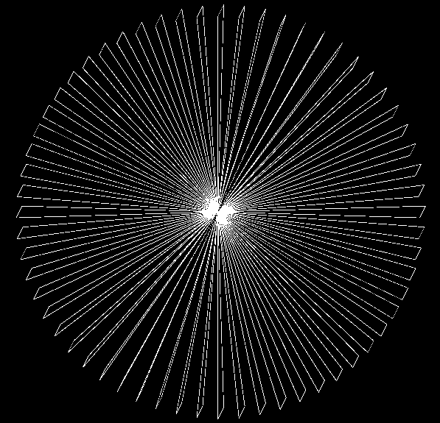
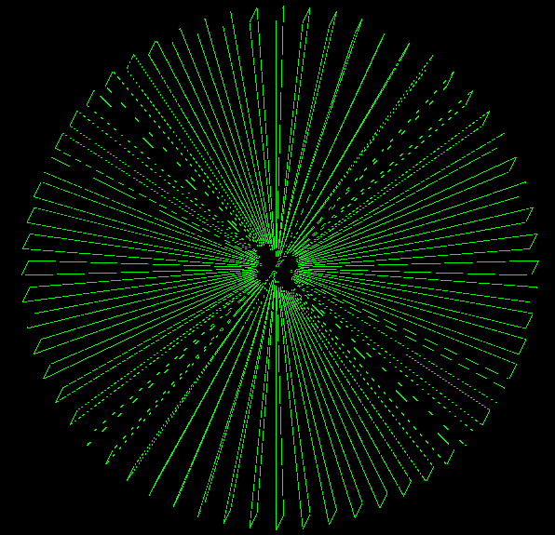
Masking
Can help avoid excessive corner smoothing
Reduces processing time
Found Edges
After Masking

Slide 20
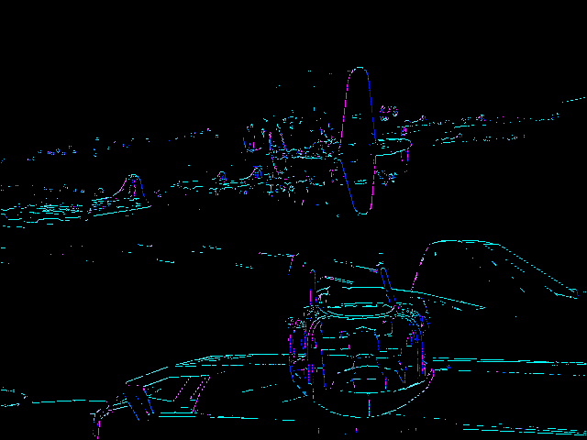
Pass 3
Compute “gradients”
Notes:
Do the least squares here.

Slide 21
Pass 4
Calculate the final frame buffer color for the pixels from Pass 3 using the presented integration method with input samples from a 3x3 pixel neighborhood
Integration and weights are computed in shader
All other pixels were already filtered in Pass 1

Slide 22
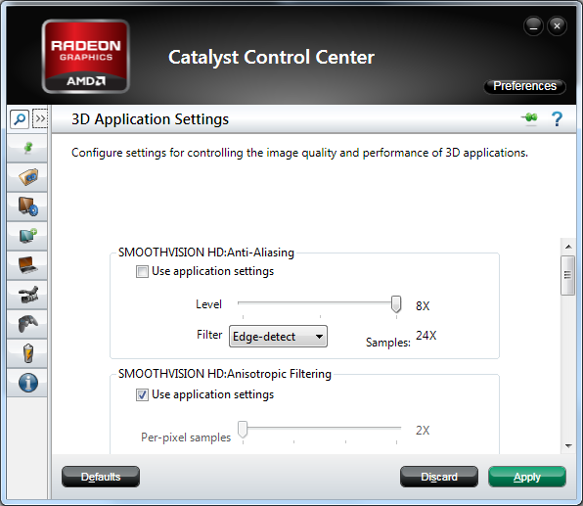
Conclusion
Runs in real-time
No HW or SW modifications needed
Go outside of the pixel
Use GPU for more complex processing
Notes:
8x = 24x
4x = 12x
2x not very interesting

Slide 23
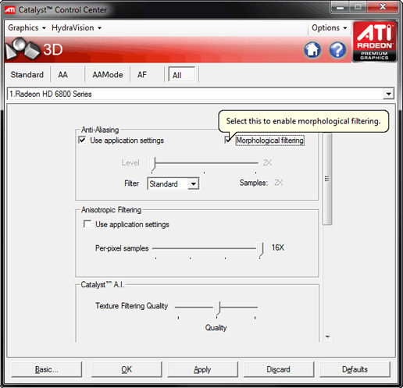
One Problem
Still relies on HW samples
Problem for deferred rendering
Lost geometry data
Morphological Anti-Aliasing…

Slide 24
Future?
The world will move to new hardware sometime soon
Interesting DX11 and GL4.x features
More flexible AA
Run shaders at sample rate
Compute shader – interesting data structures and better performance

Slide 25
References
jasonc.yang@amd.com
http://developer.amd.com/gpu_assets/AA-HPG09.pdf
http://sites.amd.com/us/game/technology/Pages/morphological-aa.aspx

Slide 26
Trademark Attribution
AMD, the AMD Arrow logo and combinations thereof are trademarks of Advanced Micro Devices, Inc. in the United States and/or other jurisdictions. Other names used in this presentation are for identification purposes only and may be trademarks of their respective owners.
©2011 Advanced Micro Devices, Inc. All rights reserved.

