Slide 1
Filtering Approaches for Real-Time Anti-Aliasing
http://www.iryoku.com/aacourse/

Slide 2
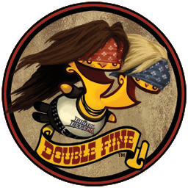
Filtering Approaches for Real-Time Anti-Aliasing Hybrid CPU/GPU MLAA (on the Xbox 360)
Pete Demoreuille
pbd@pod6.org

Slide 3
MLAA
Algorithm well described by this point
As well as benefits and drawbacks
This talk focuses on
Shipping hybrid CPU/GPU implementation
Assorted edge detection routines
Integration and use in engine
Notes:
Prior presenters have well explained the MLAA algorithm and some implementation approaches, as well as some of the motivations for its use (alternative to MSAA, lower memory, application to deferred shading) and some of the drawbacks (fonts, unnecessary blurring, cost etc).
In this talk we’ll describe an implementation that has been used in several titles for the Xbox 360, one that has very low (and fixed) GPU costs and makes MLAA an option on the platform. We’ll also touch on some of the techniques developed to adapt the edge filtering to each title’s visual style, and general implementation and deployment notes relevant for any real-time application.

Slide 4
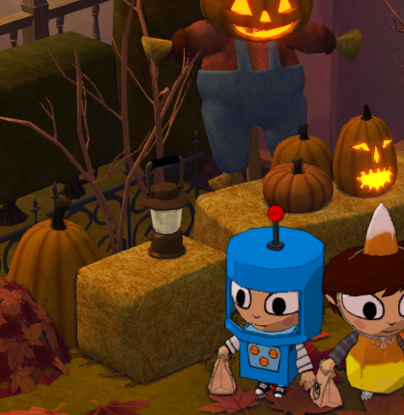
Example Results
Notes:
Prior presenters have well explained the MLAA algorithm and some implementation approaches, as well as some of the motivations for its use (alternative to MSAA, lower memory, application to deferred shading) and some of the drawbacks (fonts, unnecessary blurring, cost etc).
In this talk we’ll describe an implementation that has been used in several titles for the Xbox 360, one that has very low (and fixed) GPU costs and makes MLAA an option on the platform. We’ll also touch on some of the techniques developed to adapt the edge filtering to each title’s visual style, and general implementation and deployment notes relevant for any real-time application.

Slide 5
Example Results
Notes:
Prior presenters have well explained the MLAA algorithm and some implementation approaches, as well as some of the motivations for its use (alternative to MSAA, lower memory, application to deferred shading) and some of the drawbacks (fonts, unnecessary blurring, cost etc).
In this talk we’ll describe an implementation that has been used in several titles for the Xbox 360, one that has very low (and fixed) GPU costs and makes MLAA an option on the platform. We’ll also touch on some of the techniques developed to adapt the edge filtering to each title’s visual style, and general implementation and deployment notes relevant for any real-time application.

Slide 6
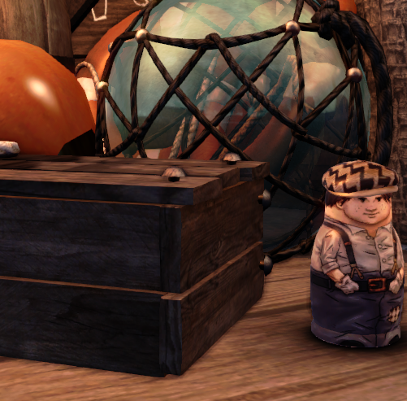
Example Results
Notes:
Prior presenters have well explained the MLAA algorithm and some implementation approaches, as well as some of the motivations for its use (alternative to MSAA, lower memory, application to deferred shading) and some of the drawbacks (fonts, unnecessary blurring, cost etc).
In this talk we’ll describe an implementation that has been used in several titles for the Xbox 360, one that has very low (and fixed) GPU costs and makes MLAA an option on the platform. We’ll also touch on some of the techniques developed to adapt the edge filtering to each title’s visual style, and general implementation and deployment notes relevant for any real-time application.

Slide 7
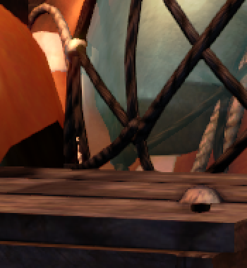
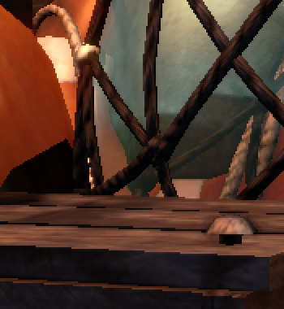
Example Results
Notes:
Prior presenters have well explained the MLAA algorithm and some implementation approaches, as well as some of the motivations for its use (alternative to MSAA, lower memory, application to deferred shading) and some of the drawbacks (fonts, unnecessary blurring, cost etc).
In this talk we’ll describe an implementation that has been used in several titles for the Xbox 360, one that has very low (and fixed) GPU costs and makes MLAA an option on the platform. We’ll also touch on some of the techniques developed to adapt the edge filtering to each title’s visual style, and general implementation and deployment notes relevant for any real-time application.

Slide 8
Motivations
Engine uses variant of deferred rendering
GPU time at a premium, prefer fixed cost
SSAA (!) originally used, needed alternative
Complicated by time pressure
Added right before shipping Costume Quest
Aspects of implementation show this
Notes:
Briefly, we were forced to abandon Costume Quest’s original antialiasing approach of supersampling (at 1520x848), which was originally chosen in the interest of implementation speed. As the game sped towards release, the heavy performance toll placed on the GPU by SSAA, compounded by the increasing quantity of art, heavy use of lights and transparency made the approach no longer tenable (not just the 50% increase in pixels, but additional passes required due to the lack of tiling support). It also didn’t improve quality as much as desired (especially compared to the cost), particularly on the PS3. But there was a very strong desire to ship with some sort of antialiasing, and not enough time to get tiling functioning on the XBOX.
A month or two before, I had read about MLAA on the realtimerendering.com blog, and thought about a few ideas that might make the technique feasible for realtime use. Quickly those loose ideas became a risky, last ditch plan to improve rendering performance and hopefully retain good image quality. We hoped to get a pre-release version of Sony’s SPU MLAA, to make sure both SKUs had high quality visuals.
Many of the details of the implementation bear the mark of this time pressure – efficient time use was of the essence, since by this time the studio’s total graphics programmer bandwidth was 50% of one person, responsible for 4 games in production!

Slide 9
Starting Points
Reference implementation from paper
Took unspeakable amount of time on PPC
First-pass fixed-point implementation
Took ~90ms (not include untiling!)
~21ms for edges, ~4.5ms blending
~65ms for blend weight calculations
Notes:
The original implementation using the reference code took a very, very long time (though on my U7300 1.3ghz laptop, it only took ~40-50ms).
A first-pass at converting the code to a more PPC/Console friendly form was done, and though it was still quite slow, it showed some promise.
At this point the idea to split the implementation and do the edge and blending calculations on the GPU was first seriously considered, while the remainder would run on the CPU.
I freely admit the idea may have been swayed by the often enjoyable challenges encountered when making the CPU and GPU communicate in such a way!

Slide 10
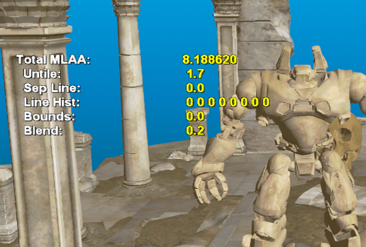
Starting Points
Fully on cpu, fixed point
~4fps (90ms aa)
Gpu edges + rest on Cpu, optimized masks
~68fps (8ms aa+untile)
Sample Art Courtesy of Microsoft
Notes:
Some key points in the prototype: a first pass at making the code run more than 1fps (not counting tiling), and after the edge detection had moved to the GPU and blend weight computation had improved a great deal. After this the implementation moved in-engine and further optimizations and threading was done.

Slide 11
Hybrid MLAA: Overview
GPU edge detection
Variety of color/depth/id data used
CPU blend weight computation
Fast transpose using tiling and VMX 128
GPU blending
Notes:
Our implementation consists of three major steps.
Edge detection, using a variety of depth, normal, and id buffers in conjunction with raw color data is performed on the GPU. When complete, the GPU notifies a CPU via an interrupt that the data is ready.
This edge data is then read on the CPU to form two blend masks (horizontal and vertical). The major issue in doing this quickly is reducing the amount of bandwidth used by the algorithm, in part by avoiding a vertical edge scan by performing a fast transpose of the input edge data. Once complete, the CPUs will notify the GPU that the blend data is available using an asynchronous resource lock (or async command buffer).
These final buffers (blend masks) containing blending weights are then used by the GPU to filter the near-final image.

Slide 12
Hybrid MLAA: Timeline
GPU
CPUs
GPU
Image From PIX for Xbox 360
Notes:
This example timing capture from Stacking (on a reasonably light frame, to help make this legible) illustrates the various stages of the algorithm and the relative time used.
Each of the horizontal bars below represent the various hardware threads on the Xbox 360, and the two blue boxes in the center represent MLAA processing.
The dotted blue arrows show the flow of data.
Along the top, surrounded in green and red boxes, is the GPU workload. The timing starts and stops at vertical blanks, as this image shows a single frame.
Note there is some amount of time left before the GPU would stall on CPU results, even though this frame is already somewhat heavy on blend mask time, making it very unlikely the GPU would stall on edge data.

Slide 13
Blend Mask
CPU blend mask generation
Contains weights for GPU use when filtering
GPU to provide input data
Flags for horizontal / vertical edges
Intensity values for blending calculations
Hypothesis: calculation bearable, bandwidth not
Fist reduce size as much as possible
Notes:
The two images which hold horizontal and vertical blending weights for neighbor pixels we will call the blend masks.
These are computed from edge and luminance data provided by the GPU.
From the original test implementation, we knew that bandwidth would be as large an issue, if not more, than the amount of calculations going on, so reducing it was a primary goal.

Slide 14
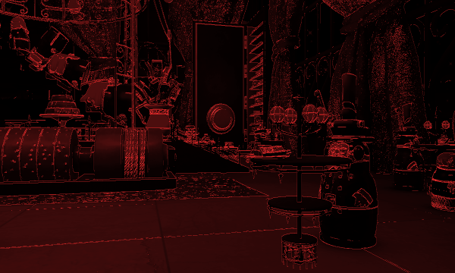
Blend Mask Input
Use 8bpp: 6-bit luminance, 2-bit H+V edge
Our implementation actually uses 16bpp, 1 channel for other stuff
Notes:
The first step in doing this was passing less data from the GPU to the CPU. We use 8bpp, which is split into a 2 bits of horizontal and edge flags, and 6 bits of luminance data.
In our actual implementation, we actually use a 16bpp target which contains the edge data along with other unrelated data into the second channel. This was mainly to save a little GPU time.
It should be noted that this data is passed from the GPU in a tiled format, making it unsuitable for use on the CPU. After receiving the data, a (very slow) function from the XDK was originally used to untile the image, which it was assumed could be made faster later.

Slide 15
Blend Mask Input
Large reduction, bandwidth still an issue
Vertical edges obliterate cache
Transpose image!
Do Not Want
Do Want
Notes:
This greatly reduces the cost for horizontal blend mask generation (and enables some additional optimizations), the vertical blend mask generation is still horribly slow due to the cache-unfriendly access pattern.
An obvious solution would be to transpose the image, but exactly how to accomplish that in an efficient manner was slightly less obvious.

Slide 16
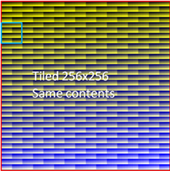
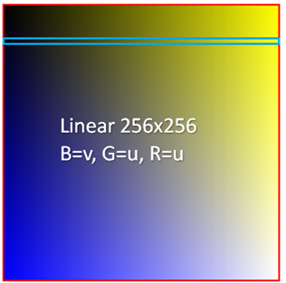
An Aside: Tiling
GPU
wants
CPU
wants
annoyance?
Images Courtesy of Microsoft
Notes:
What was originally just an annoyance ended up providing an excellent solution to the problem.
We could utilize the fact that a tiled image has blocks of the image arranged linearly in memory, so we could read in small square regions, transpose them, and write out the blocks in a transposed pattern.
Doing this over the whole image allows us to transpose it in a very cache and CPU efficient manner.

Slide 17
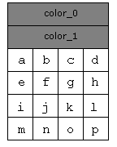
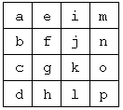
Not an Annoyance
DXT blocks
- One read for 4x4 pixels
4x4 pixels
64 bits in memory
“Untile”
VMX
Notes:
Instead of going into the intricacies of Xbox texture tiling, we’ll use the familiar example of DXT blocks.
The key insight is that encoding patterns like this allow a single aligned, linear, easily prefetchable read to load a rectangular block of pixels. One can then take care to load a square block using VMX128/Altivec/ your vector instruction set of choice, transpose that, and write out both an untiled and untiled+transposed image simultaneously.
Prefetching carefully and trying to make the best tradeoff of block size, instructions count to transpose each block, read bandwidth per instruction, etc is simply labor from that point on. The untile in our implementation also discards 8 bits of the 16bpp texture produced by the GPU, and operates on 32x32 blocks which are processed as 4 8x8 sub-blocks, two of which fit into a set of vector registers at once.
The new FastUntile sample application in the XDK is an excellent starting point for performing the untile quickly.

Slide 18
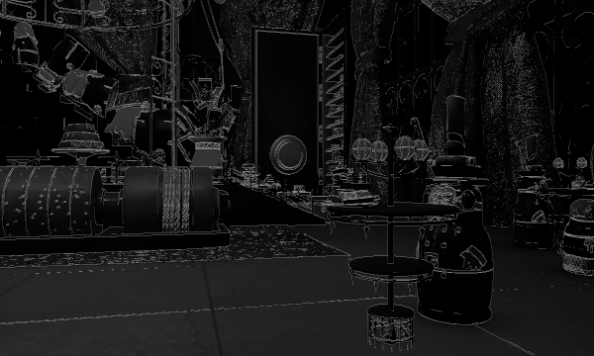
Multiple tiles
Read from few cache lines
Store original and transpose
Into blocks of vector registers
Notes:
A visual example of progressing blocks of pixels and how they might be written out.

Slide 19
Blend Mask: Transpose
Untile creates horizontal, vertical images
We convert from 16bpp -> 8bpp here as well
Notes:
In summary, we take something which looks nothing like an image and convert it into two 8bpp images containing horizontal and vertical edges.
We then run the MLAA algorithm on these two images.

Slide 20
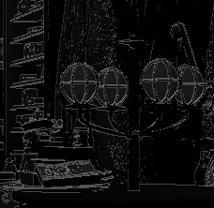
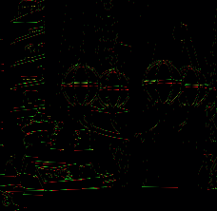
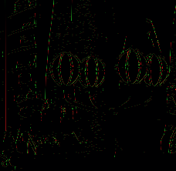
Blend Mask
Now run horizontal mask code twice
Massive bandwidth reduction
Horizontal edges
Vertical edges
Notes:
Our implementation uses an optimized version of the reference code – not many functional modifications were originally made besides a few changes to blend weight calculations.
The fact that we only perform horizontal blend mask generation makes additional optimizations possible, and makes the code much easier to maintain.

Slide 21
Blend Mask: Threading
Last major step: threads
Process interleaved horizontal blocks
Jobs kicked as untiling of blocks completes
L2 still warm when mask generation starts
Wait for complete untile before vertical mask
Final cost ~4-8ms per thread
Tons of potential optimizations left
Notes:
Threading was the one of the last steps, which does further complicate the careful balancing of cache prefetching and bandwidth usage. The speedup was certainly not 1:1 with each thread added, and titles so far end up using two threads total.
The threading pattern arrived at is similar to the reference code’s, interleaved horizontal blocks of the image are processed in a way that two adjacent blocks are not used simultaneously. A single thread is responsible for locking the GPU resources, untiling the image and submitting work, and will then processes blocks once untiling is complete.
It should be noted that the core MLAA code has many remaining opportunities for optimizations, both with respect to the speed of the code and additional preprocessing that could be cheaply done on the edge data to allow more efficient skipping of empty space, line length searches, etc. Many of the ideas presented in the GPU implementations could be adapted to optimize the CPU code (particularly those that limit the total size of processed edges).

Slide 22
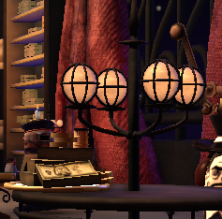
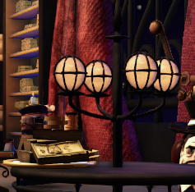
Blending
GPU reads horizontal and vertical masks
Linear textures, but shader is ALU bound
Performed with color correction, etc
Notes:
Blending is straightforward. In one of our final post-processing shaders (that is ALU heavy), we read the blend masks and blend between adjacent pixels in the image to produce the final, antialiased image.
We currently blend all four neighbors, but based on preliminary results from Jimenez’s MLAA, using bilinear filtering to blend only the dominant horizontal and vertical neighbor may produce similar results while reducing total blending time.

Slide 23
Edge Detection
GPU offers additional options
Augment color with stencil, depth, normals
Cheaper to use linear intensity values, if desired
Still must work to avoid overblurring!
Image quality suffers (toon-like images, fonts, etc)
Uses excessive CPU, forcing throttling
Notes:
As our edge detection is processed on the GPU, a whole wealth of new options is available to us. Most notably, it becomes cheap to use additional buffers and linear-intensity values when computing edge data.
Adapting the edge detection to the individual style of each game was essential to get stable filtering and avoid too much overblurring.
All that said, overblurring can still be an issue, particularly on fonts and Costume Quest’s toon-like visual style. Fine texture detail could become much less legible due to MLAA, along with the cell-shaded outlines around the characters. All reasons why Costume Quest used stencil (material) edges in addition to color edges.

Slide 24
Depth-based Edges
Start with technique from Brutal Legend
Our best results are with raw/projected Z
But hard to tune absolute tolerance
Use ratio of gradient and center depth plus bias
Notes:
We found that pure color edges often did not provide very stable or desirable results (both missing edges and overblurring areas of the image).
We had some experience with edge detection from depth and materials from the antialiasing approach used in Brutal Legend, and this provided a starting point to improve the quality of edge detection.
Using a relative difference from the center pixel provides a way to avoid two issues with depth-based edges
Avoiding flat sloping surfaces from being flagged as edges
Edge tolerance falling off with distance
Note that these assume your near values are at 0, far values 1.

Slide 25
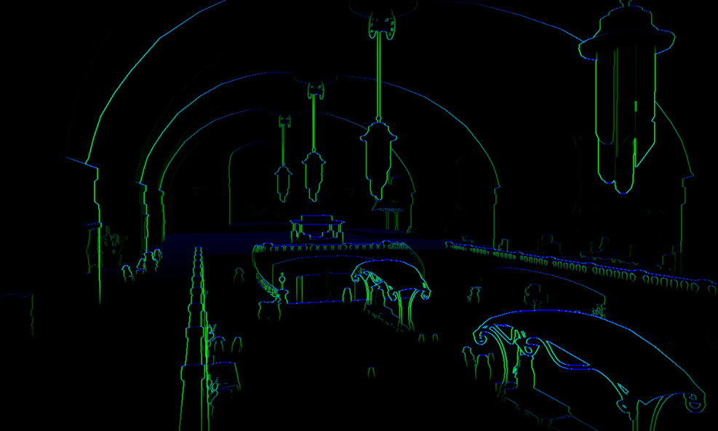
Depth-based Edges
Absolute Tolerance
Relative Tolerance
Notes:
Flat areas can

Slide 26
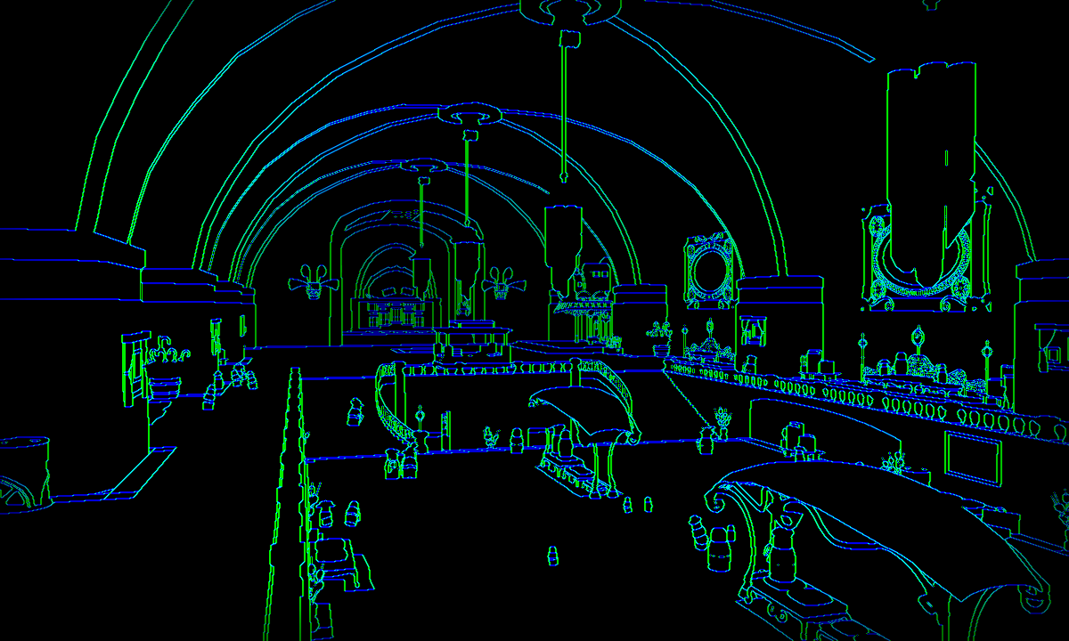
Material-based Edges
Use a few stencil bits for per-material values
Material edges
Depth Edges
Notes:
Using material-based edges will detect edges that depth edges would normally miss, and is very stable. However, it may add more edges than normally desired and cause overblurring.
This said, for games without large view distances and no need to reduce edge detection tolerance in the distance, material edges may be preferable due to their stability and simplicity.

Slide 27
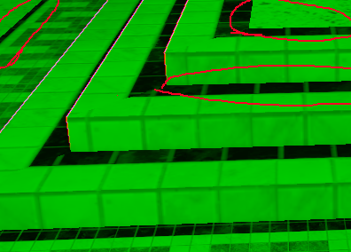
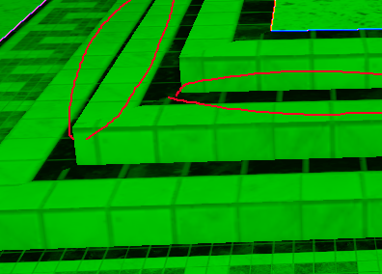
Neither a panacea
Even combinations fail
Choose best for your app (or add more sources)
Depth
Material
Notes:
But neither handles everything. (Though adding normal-based edges would find the horizontal edge this particular case)

Slide 28
Edge Detection
Costume Quest used a blend
Material edges used to increase color tolerance
Stopped short of using normal edges (GPU cost)
Stacking went simpler
Pure color/luminance thresholds, with tweaks
Skip gamma, use x^{^2} to save fetch cost (or x^{^1}…)
Notes:
Costume Quest ended up using a scheme where stencil/material edges were used to increase the sensitivity of color edges. This lead to stable edge detection for almost all situations, but without adding edges that wouldn’t visibly reduce aliasing.
Stacking went even simpler and used only the color buffer, but added a few tweaks to improve quality, help performance and avoid some degenerate scenarios.
Stacking also used a linear lighting pipeline, so linear color values were needed – but we only used an approximation to save texture fetching cost, the difference is very minor (in some cases it actually helps).

Slide 29
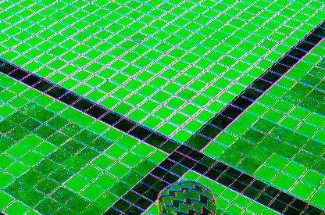
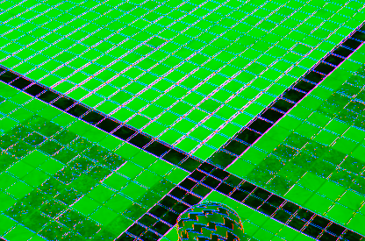
Avoiding Overblurring
Adjust tolerance based on local contrast
Similar to depth approach
Notes:
One of the tricks used in Stacking was a local adjustment of the edge threshold based on the luminance of the pixel and its neighbors, reducing edges to just the most contrast-y areas. This is particularly helpful reducing the amount materials with high frequency details are blurred.

Slide 30
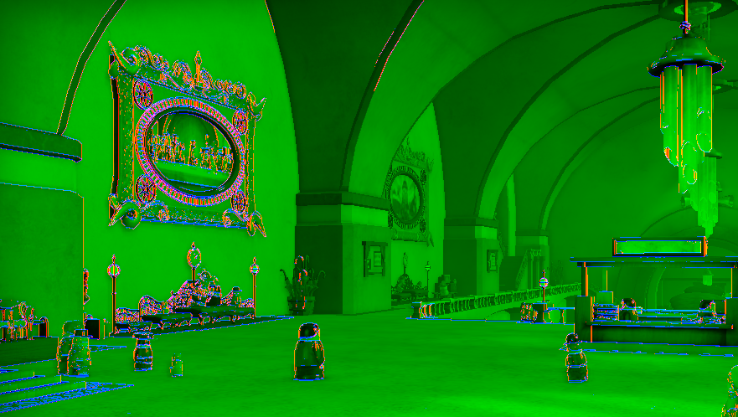
Skip Unneeded work
Cutoff MLAA where fully out of focus
Notes:
Stacking also omitted edge detection at depths that would be fully out of focus, as the depth of field adequately hides aliasing.
Note that filtering the edges in the depth range where objects are transitioning from in focus to out of focus does provide noticeable quality improvements.
It may however make the latency of the blend weight calculations more difficult to hide, any DOF blurring passes would need to wait for MLAA results.

Slide 31
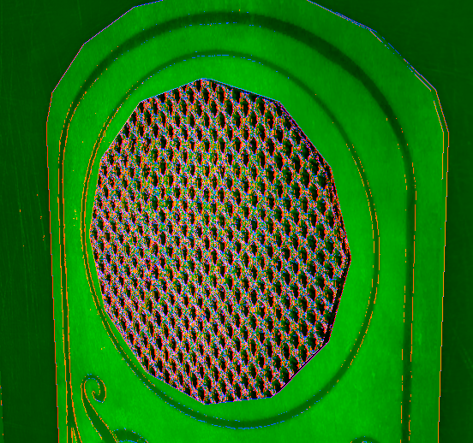
Backup Plan
Plan for the worst case
Close view of high frequency materials
Enforce wall-clock CPU budget
Can adaptively change threshold
“Interior” flag could help
Notes:
In some titles, there were certain materials and areas where the player could get a screen-full of edges, causing a noticeable decrease in performance due to the heavy CPU load.
In some situations, a simple PID controller was used to adjust the edge tolerance dynamically, reducing it whenever CPU time was growing, and increasing it to normal whenever load was below average. To handle the worst situations, a hard wall-clock budget of CPU time was enforced, simply skipping any remaining blend mask generation work and allowing the GPU to complete. This could cause some small amounts of flicker, but these were rarely very noticeable as the skipped work was generally contained within the last several vertical tiles.

Slide 32
Integration
Memory required: 4x 8bpp buffers
Edge input, blend masks, two temporary buffers
Could reduce using pool of tile buffers
Latency hidden behind post, parts of next frame
Applied after lighting, before DOF+Post+UI
GPU cost varies, 0.4-0.7ms plus z-buffer reload
Lower when work can be added to existing passes
Notes:
Memory requirements are fairly low, and could be reduced further by untiling the horizontal image into a smaller set of temporary buffers, or performing the horizontal untile in-place, reusing the input edge buffer.
Latency is hidden by performing other work (bloom, dof precalculations, and parts of the next frame) while the blend masks are being computed.
We perform MLAA before any UI or postprocessing (though taking into account any postprocessing color changes, etc may have in edge detection may be worthwhile).
Final GPU cost varied between each title, and was mainly dependent on the type of edge detection used and how much MLAA work could be combined into existing shaders (for example, putting texture-heavy MLAA work in ALU-heavy shaders, or shaders that already fetched most of the data needed by MLAA, using the MLAA blend as cheap depth of field blur, etc). The lowest integration cost was approximately .34ms, while on average it costs .5-.6ms. In our integration, this cost is supplemented with the cost of a z-buffer reload.

Slide 33
Future Work
Better edge detection
Quality improvements
Many optimizations to code possible
And some to GPU passes
Many ideas described in this course applicable!
Notes:
It should be clear that many additional optimizations are still available, and many of the approaches suggested in this course provide additional avenues for optimizations and quality improvements.

Slide 34
Thank You!
Questions:
pbd@pod6.org

