Slide 1
Filtering Approaches for Real-Time Anti-Aliasing
http://www.iryoku.com/aacourse/

Slide 2
SRAA: Subpixel Reconstruction Anti-Aliasing
Morgan McGuire¹ Matthäus Chajdas² Sergey Puchin Miguel Sainz David Luebke
NVIDIA
Also affiliated with: (1) Williams College (2) Technische Universität München
Notes:
If you learn one thing in this course, it should not be about SRAA. It should be …

Slide 3
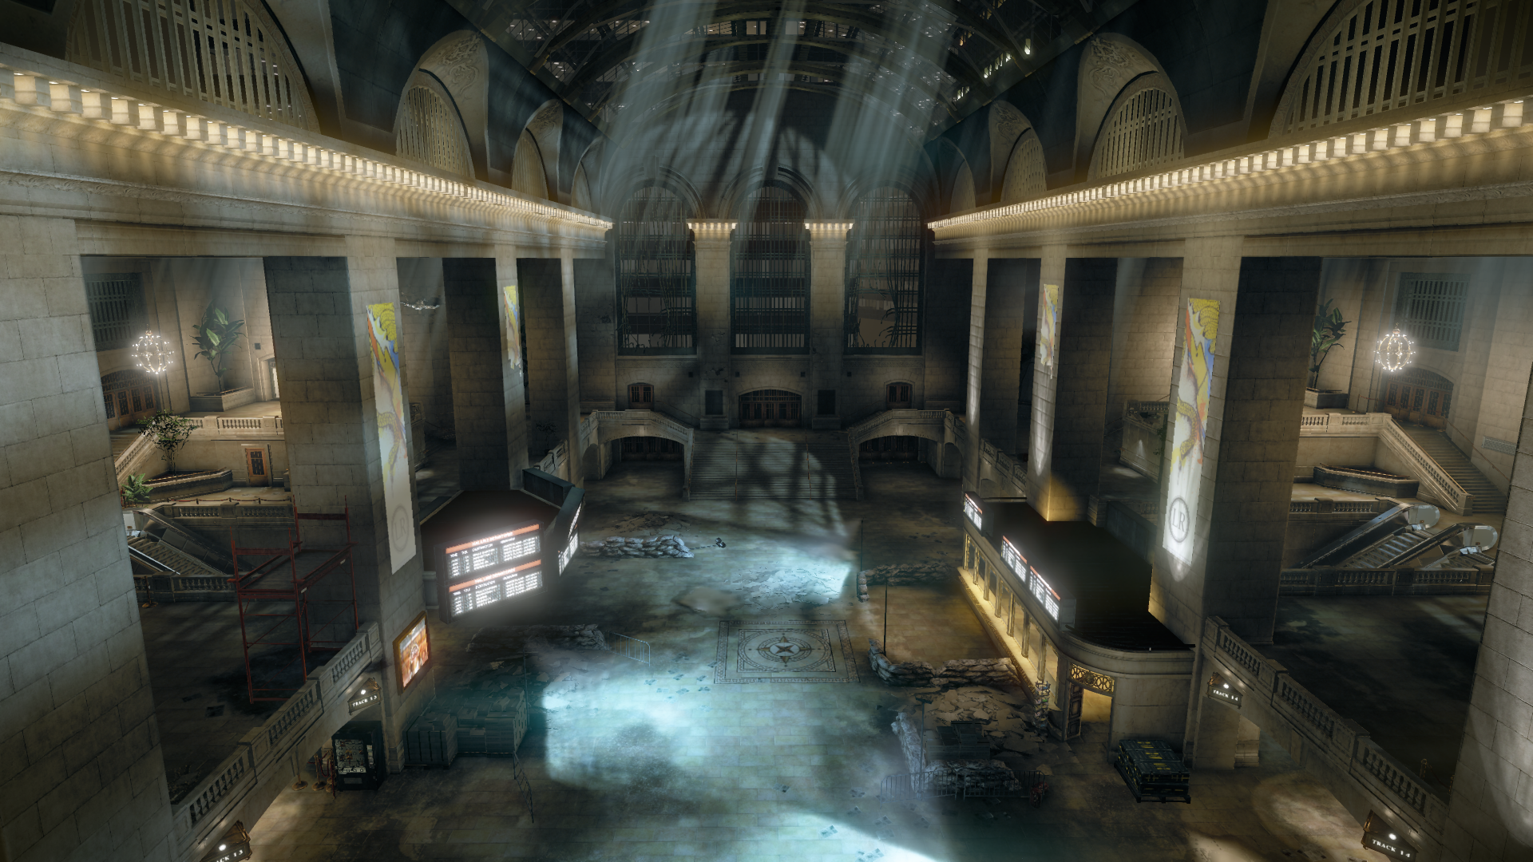
SRAA result
Data courtesy of Crytek from Crysis 2
Notes:
I’ll zoom in on two areas with features on the order of one pixel thick.

Slide 4
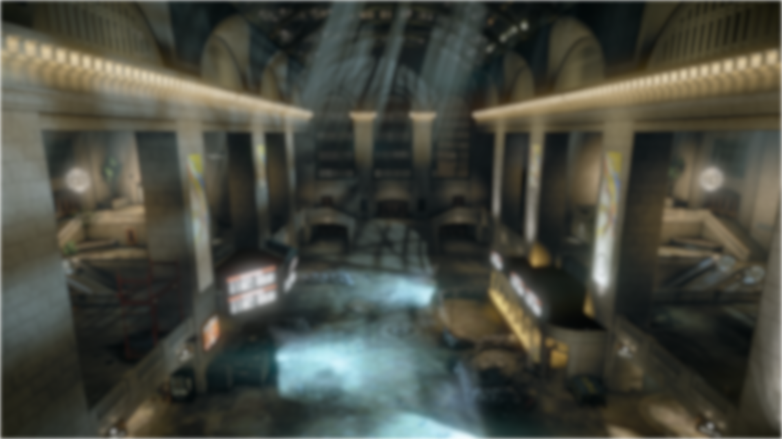
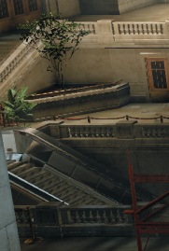
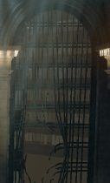
SRAA result
Data courtesy of Crytek from Crysis 2
Notes:
You can see that SRAA produced antialiasing here comparable to MSAA…even though we didn’t shade more than once per pixel, even when there were multiple objects in the pixel.
SRAA tracked 4x MSAA depth and then looked at nearby pixels to find shades for each of the four depth samples independently, allowing the shading and color to flow along thin objects for antialiasing. It doesn’t work if there’s an object that is so small that it only covers one sample ever, but it works well for individual thin objectslike wires and collections of single-sample objects like debris.

Slide 5
SRAA
SRAA is research targeting cases where 1 spp morphological approaches fail
Combined with another method for edges
Performance and quality improvements since I3D 2011 paper (NVIDIA tech report coming soon)

Slide 6
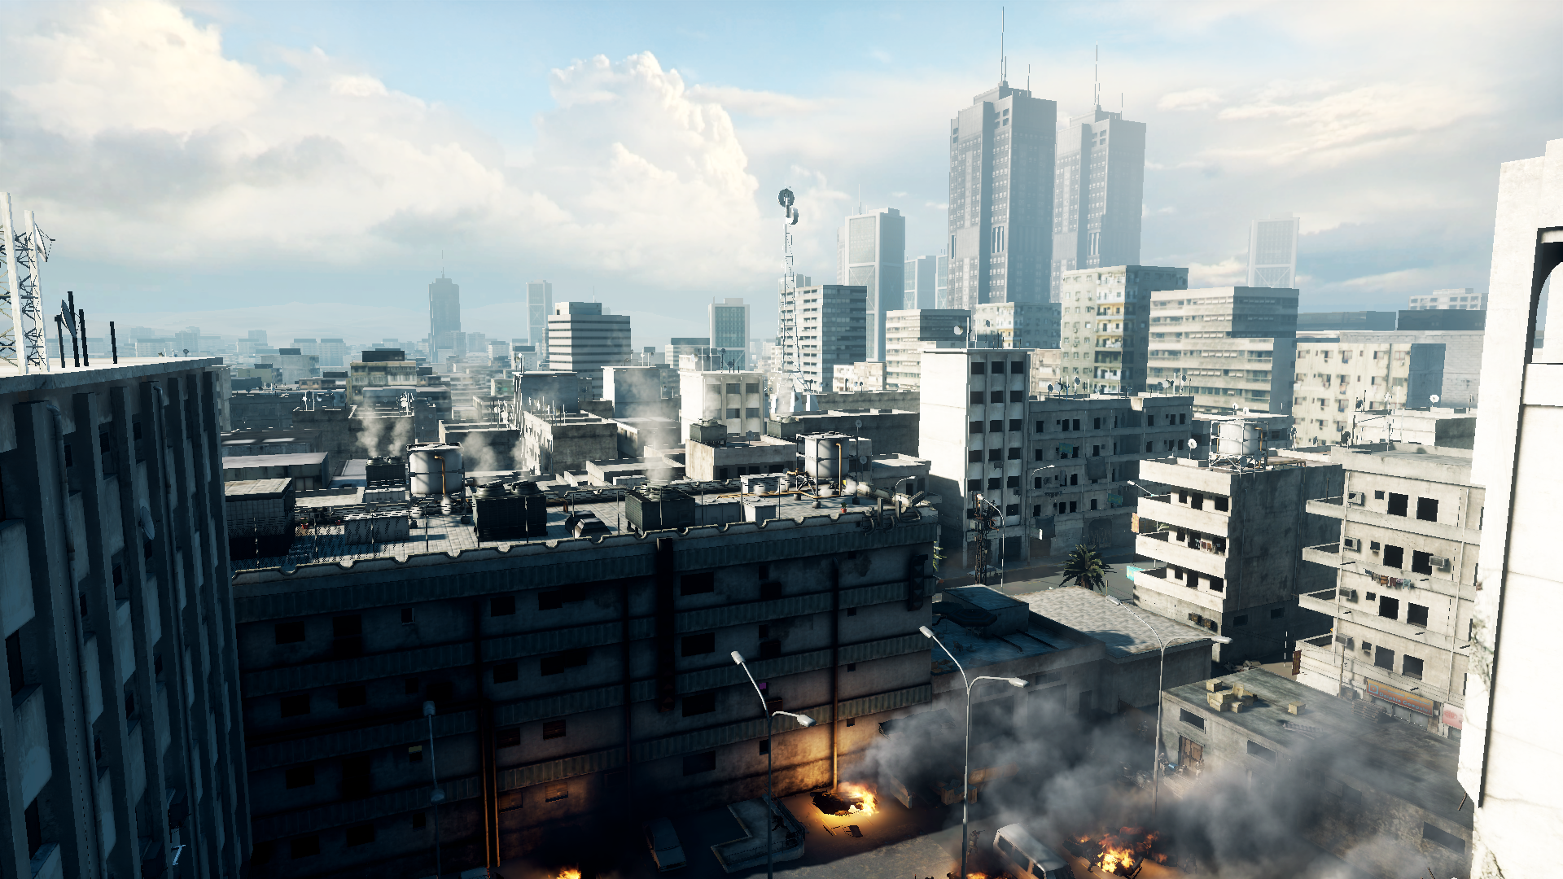
1 sample-per-pixel input
Data courtesy of DICE from Battlefield 3
Notes:
Here’s a scene by DICE rendered with one sample per pixel at 1080p. This is the input that you provide to a post-processing antialiasing algorithm.
I’m going to zoom in on three areas to show you how SRAA performs on this scene.

Slide 7
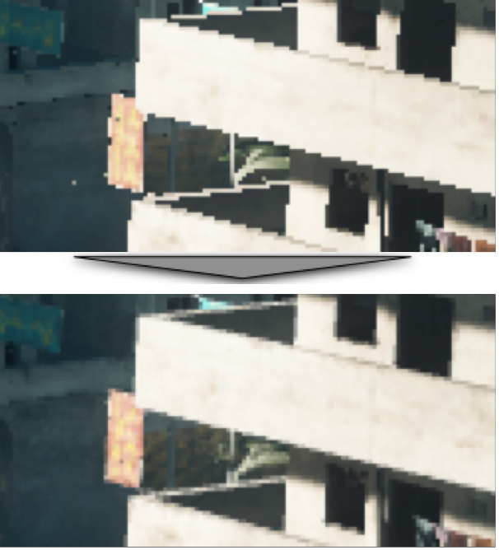
Edges
Input
SRAA
Output
Data courtesy of DICE from Battlefield 3
Notes:
This balcony is dominated by high-contrast edges between large polygons.
SRAA produces a result comparable to MSAA on this input without any adjustment, but we’ve seen that morphological methods can surpass MSAA quality. This is the case where a subpixel should be combined with something like FXAA for superior results.
Now let’s look at the cases where morphological methods fail, which are thin objects

Slide 8
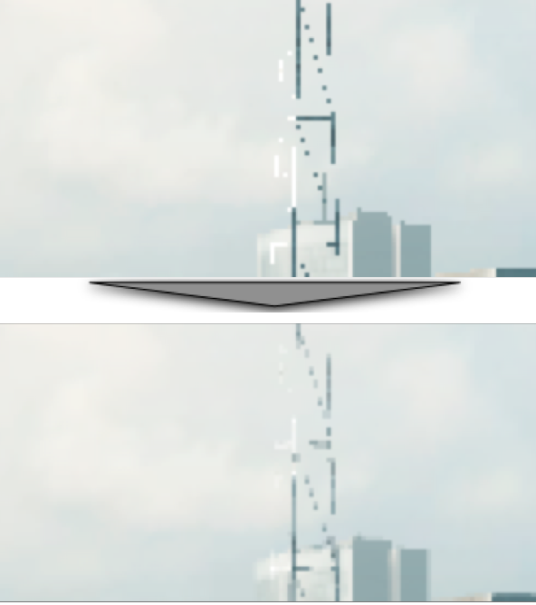
Subpixel Features
Input
SRAA
Output
Data courtesy of DICE from Battlefield 3

Slide 9
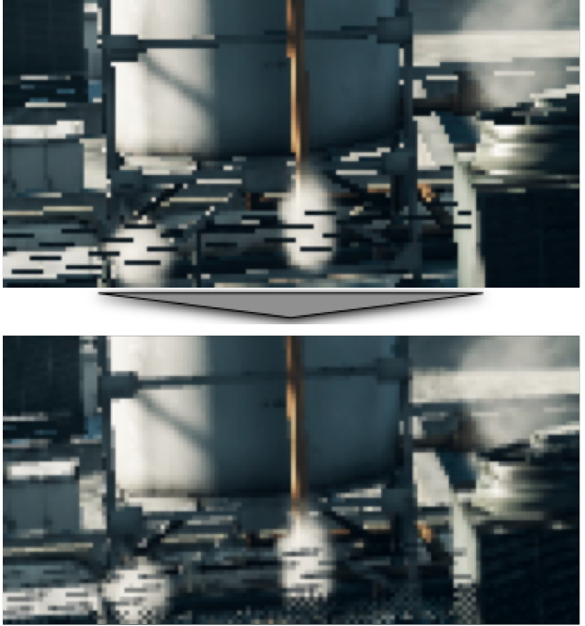
Subpixel Features
Input
SRAA
Output
Data courtesy of DICE from Battlefield 3

Slide 10
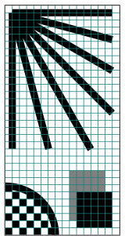
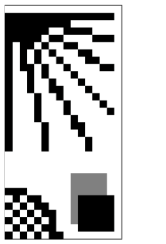
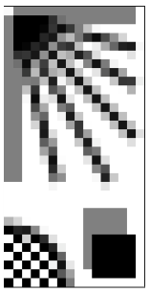
Vector Input
1x Sampled
Ideal
Notes:
Here’s a more controlled experiment to show what is going on.
We constructed this vector scene and rasterized it at 1 sampler per pixel and thousands of samples per pixel

Slide 11
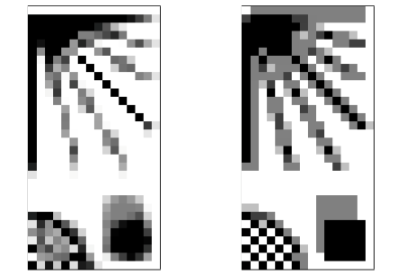
MLAA
SRAA
Ideal
Notes:
Preserve high frequencies
Preserve sharp edges that aren’t jagged from aliasing
Preserve line thickness

Slide 12
SRAA Attributes
Reconstructs subpixel precision from 1x color, e.g., for:
About 1 ms on GeForce 560 at 1080p
Requires MSAA depth buffer
Accepts optional MSAA normal/uv/ID buffers
Alternative: temporal or subpixel-morphological (SMAA)
Polygon edges
Power lines
Fences
Trees
Distant characters
CAD wireframe
Grass
Antennae
Notes:
Temporal AA was used effectively on Crysis 2 and Halo Reach.

Slide 13
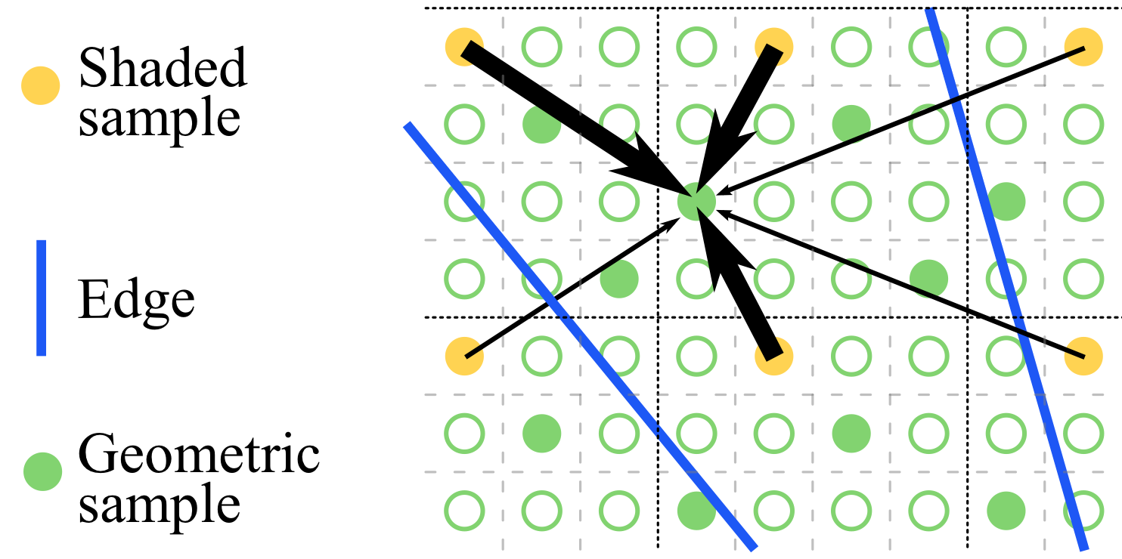
The Key Idea

Slide 14
Implementation Notes
Combine with other methods
Run FXAA on 1x color before SRAA (not shown today)
Keep alpha-blending for billboards
Primitive antialiasing on lines or select polygons
Compatible with SSAA, MSAA and CSAA
Super-sampled depth is “free”
Depth-only 4x MSAA renders 3x faster than even 1x flat shading
Depth buffer read/writes are compressed on many architectures
Still have to pay memory cost
“discard” or stencil-mask pixels without edges

Slide 15
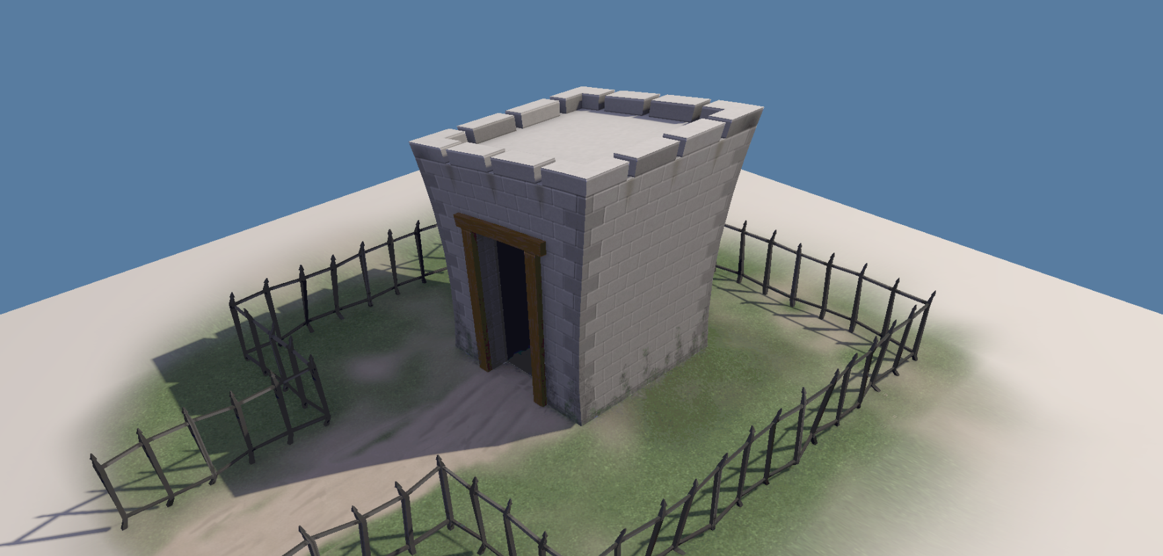
Space and quality

Slide 16
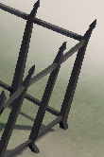
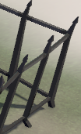
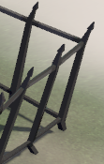
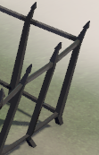
Space and quality
Input (no AA) | Depth16F | Depth16F + RGB8 Normal | R8 Primitive ID
 | 16.6 MB | 49.8 MB | 8.2 MB
All run in about 0.55 ms at 1920x1080 on GeForce 560 Ti
Notes:
Depth alone is efficient to render, but at 1080p 4x costs an additional 16.6 MB over the original framebuffer even at 16 bits per sample.
It also fails to discriminate all cases.
Additional information, such as normals, produces better cross-bilateral weights but requires significant space.
We found that as simple a heuristic as the tessellation primitive ID is sufficient for antialiasing purposes in many scenes and can be compressed into eight bits.

Slide 17
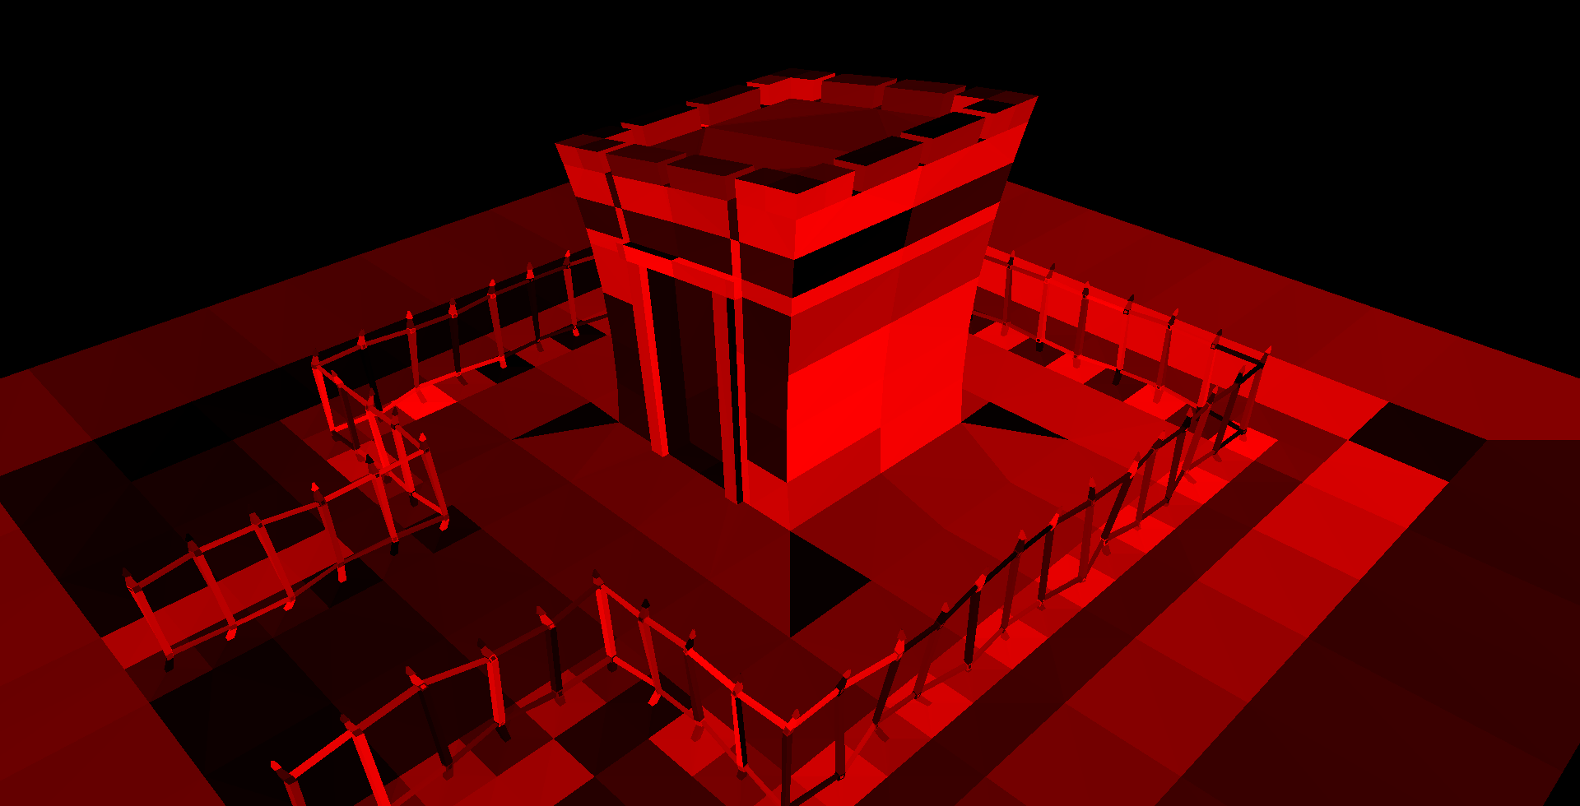
R8 Primitive ID Buffer
Notes:
Here’s what the primitive ID buffer looks like.

Slide 19
Conclusion
I currently use FXAA for large-triangle edge antialiasing
A small amount of MSAA data can improve subpixel-triangle antialiasing
FXAA + SRAA, SMAA
Primitive IDs are an effective and compact heuristic discriminator for AA

