Slide 1
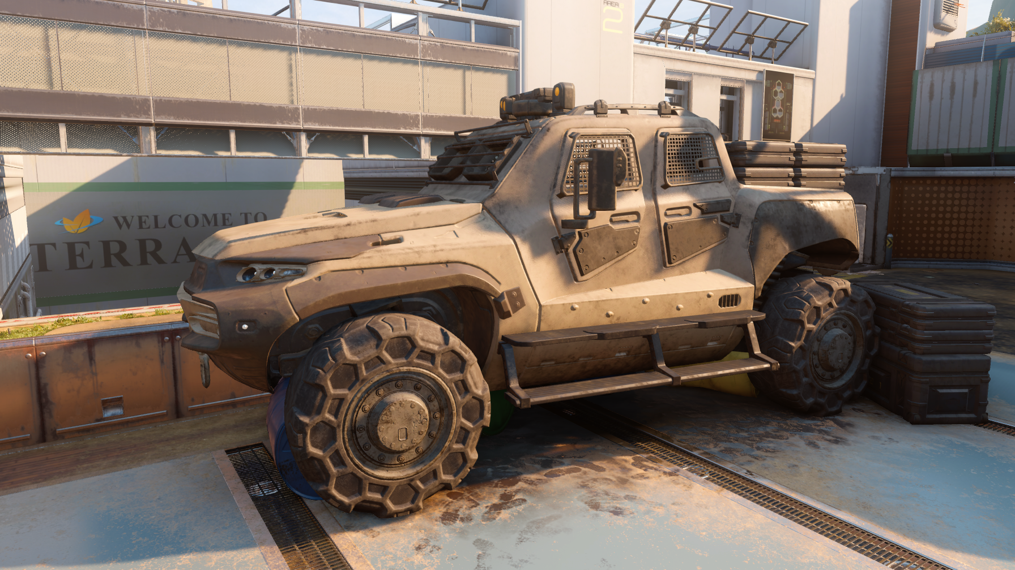
Practical Realtime Strategies for Accurate Indirect Occlusion
to
Jorge Jimenez – Graphics R&D Technical Director (Activision Blizzard)
Xianchun Wu – Graphics R&D Programmer (Activision Blizzard)
Angelo Pesce – Graphics R&D Technical Director (Activision Blizzard)
Adrian Jarabo – Post-Doctoral Researcher (Universidad de Zaragoza)
Physically Based Shading in Theory and Practice Course
© 2015 Activision Publishing, Inc.
Notes:
Hi,
Thanks for the introduction.
So, I’ll be talking about
accurate indirect occlusion.

Slide 2
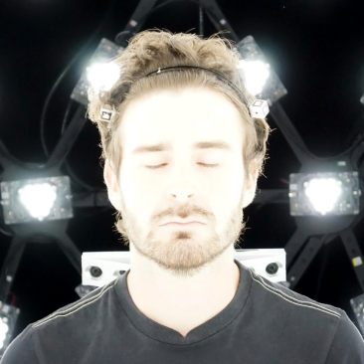
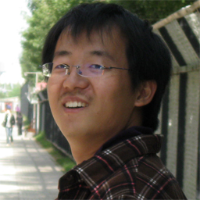
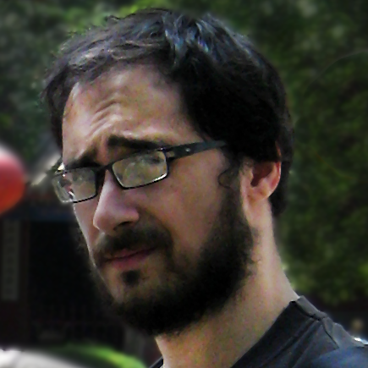
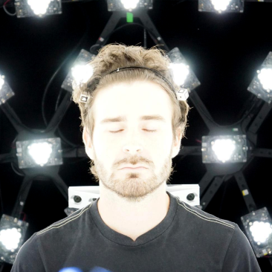
Authors
Jorge Jimenez
Activision Blizzard
Xianchun Wu
Activision Blizzard
Angelo Pesce
Activision Blizzard
Adrian Jarabo
Universidad de Zaragoza
Notes:
First of all I’d like to show all the authors of this work,
Xianchun Wu, Angelo Pesce, Adrian Jarabo and me.

Slide 3
Notice for Offline Reading
Hidden slides in this presentation
Slide show mode won’t show them
Don’t miss the speaker notes, most slides have them

Slide 4
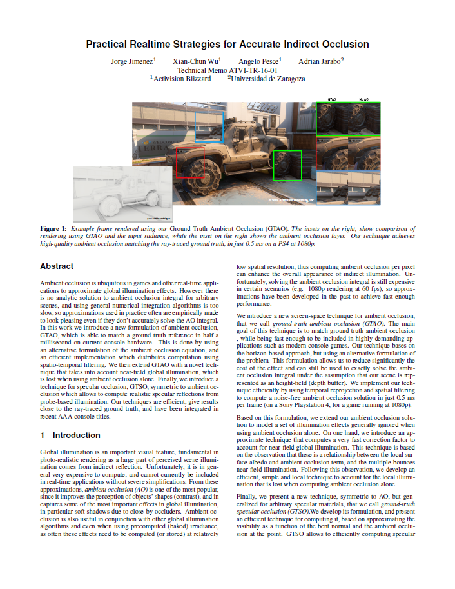
More Details Online!
Check out:
Technical report
Full slide deck online
Notes:
Due to time constraints, I’ll try to keep the talk high level.
You will find all the details online in our technical report and the full slide deck,
so we definitely recommend to check them out.

Slide 5
Yet Another SSAO?

Slide 6
Motivation
$$L_{o}\left(ω_{o}\right)=L_{e}\left(ω_{o}\right)+\int_{Ω}{f_{r}\left(ω_{i},ω_{o}\right)}L_{i}\left(ω_{i}\right)\left(n{∙ω}_{i}\right)dω_{i}$$
Physically based BRDF adoption crucial
Notes:
In the past few years, the adoption of physically-based BRDFs
has been a crucial improvement to the consistency and realism of real-time rendering.
Large efforts have been made to improve this term of the rendering equation, marked in orange.

Slide 7
Motivation
$$V(ω_{i})L_{i}^{env}\left(ω_{i}\right)$$
$$L_{o}\left(ω_{o}\right)=L_{e}\left(ω_{o}\right)+\int_{Ω}{f_{r}\left(ω_{i},ω_{o}\right)}L_{i}\left(ω_{i}\right)\left(n{∙ω}_{i}\right)dω_{i}$$
Physically based BRDF adoption crucial
Occlusion also a highly important ingredient
Diffuse
Specular
Use of HDR+PBR makes specular occlusion even more important
Notes:
And we have seen improvements in the accuracy of incoming radiance, in green,
with the adoption of environment look up tables for image-based lighting.
However, its implicit visibility term, in blue, has received less attention.
We think that both diffuse and specular occlusion are very important ingredients of the rendering equation,
and in this talk we will explore them in more detail.
Without them, no matter how accurate our BRDF and lighting models are,
we are missing that component that makes objects stick to the ground.
That makes them feel part of a connected world, rather than individually composited objects.

Slide 8
Motivation
$$V(ω_{i})L_{i}^{env}\left(ω_{i}\right)$$
$$L_{o}\left(ω_{o}\right)=L_{e}\left(ω_{o}\right)+\int_{Ω}{f_{r}\left(ω_{i},ω_{o}\right)}L_{i}\left(ω_{i}\right)\left(n{∙ω}_{i}\right)dω_{i}$$
Physically based BRDF adoption crucial
Occlusion also a highly important ingredient
Diffuse
Specular
Use of HDR+PBR makes specular occlusion even more important
Often hacked
Previous gen consoles required so
Can we use accurate solutions now?
Notes:
In real-time rendering, we often hack or heavily approximate the occlusion,
This is understandable given the constraints of the previous generation of consoles.
But the question that we asked ourselves is: do we still need to do so?
Can we use accurate approaches in reasonable budgets, under the constraints of 60 frames per second?
Bear with me, and we will discover this out…

Slide 9
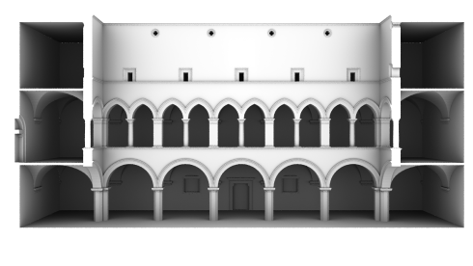
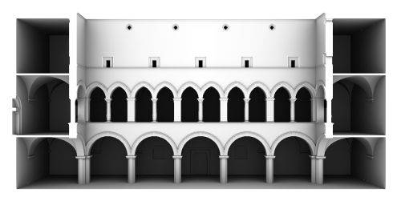
Methodology
Monte Carlo Ground Truth
Implemented critical parts twice to ensure correctness
3d ray tracer (3d geometry)
Screen-space ray marcher (height map)
Horizon-based numerical integrator
Notes:
The core of our methodology for both the diffuse and specular occlusion has been to constantly compare with Monte Carlo ground truth at each step we performed,
to ensure the correctness of our techniques.

Slide 10
Methodology
Monte Carlo Ground Truth
Implemented critical parts twice to ensure correctness
Analytical problem
Available data (engine)
Performance targets
3d ray tracer (3d geometry)
Screen-space ray marcher (height map)
Horizon-based numerical integrator
Notes:
We derived analytical solutions where possible,
and from there…

Slide 11
Methodology
Monte Carlo Ground Truth
Implemented critical parts twice to ensure correctness
Analytical problem
Available data (engine)
Performance targets
Closed-form solution + Fitting residual
3d ray tracer (3d geometry)
Screen-space ray marcher (height map)
Horizon-based numerical integrator
Notes:
…we found approximations for the residual error from the ground truth.

Slide 12
Goals
Achieve same performance as the fastest technique we had
MiniEngine SSAO: outstanding technique in terms of quality/performance
Achieve high accuracy
Make using accurate approaches a no brainer
Used in production under 60 fps constraints
0.5ms on PS4@1080p
Notes:
The ultimate goal was to achieve better quality while staying in the same performance budget as previous techniques,
making this solution a simple drop-in replacement.
For ambient occlusion, our budget was 0.5ms on the PS4 at 1080p.
Note that I will not cover optimizations during the talk, but you will find them on the online material.
MiniEngine SSAO:
https://github.com/Microsoft/DirectX-Graphics-Samples/blob/master/MiniEngine/Core/Shaders/AoRenderCS.hlsli

Slide 13
Overview
Ambient Occlusion (GTAO): $V_{d}$ in this presentation
Uniform Weighting
Cosine Weighting
Multiple Bounces
Specular Occlusion (GTSO): $V_{s}$ in this presentation
Cone/Cone Intersection Method
Cone/Lobe Intersection Method

Slide 14
GTAO Ground Truth-based Ambient Occlusion
Notes:
The first part of this talk will showcase a new screen-space ambient occlusion technique that we called GTAO.

Slide 15
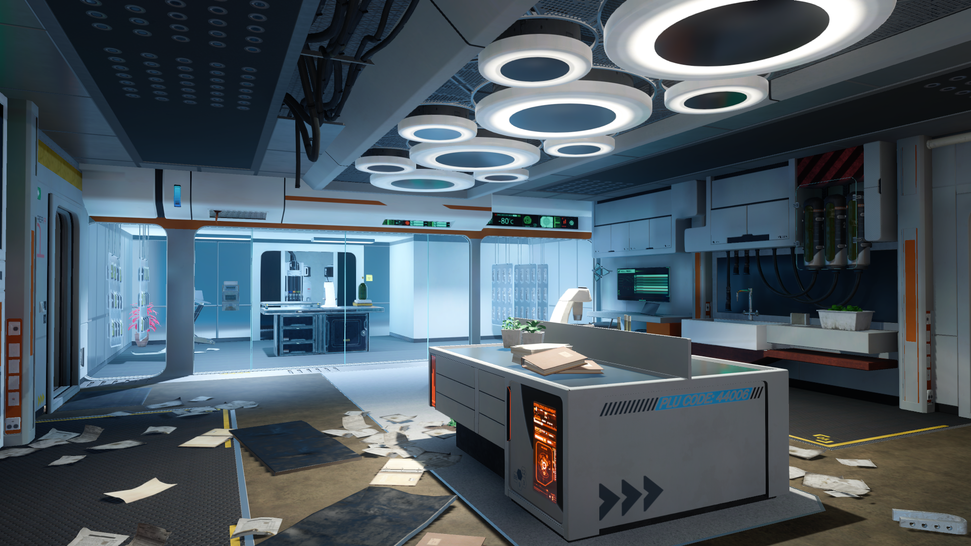
© 2015 Activision Publishing, Inc.
Notes:
I’d like to start by showing some in-engine renderings.
Here we can see an image without any indirect occlusion at all…

Slide 16
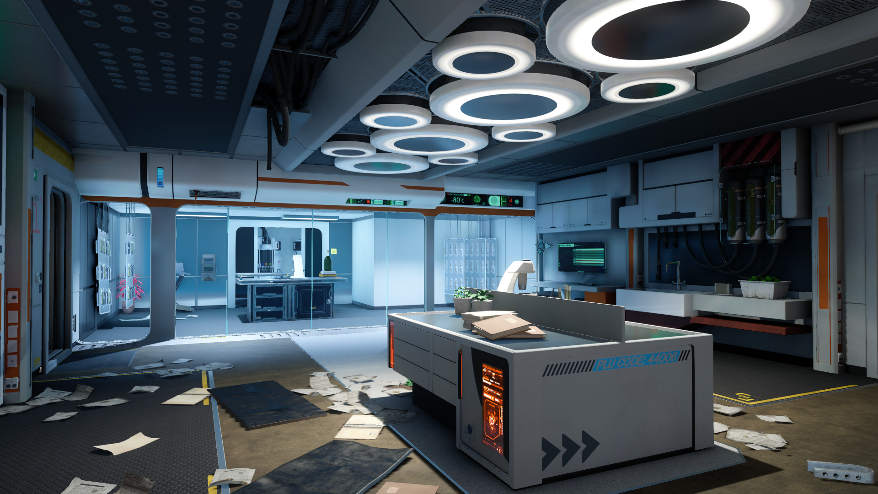
© 2015 Activision Publishing, Inc.
Notes:
…and here with GTAO.
This image clearly shows the importance of having accurate occlusion.
A key observation is that with accurate occlusion, we can see subtle but important changes in lighting in some areas, for example near the wall corners…
…but really strong changes in others, like the tubes on the ceiling.
Let’s go back and forward a couple of times so that you can observe the differences again…

Slide 17
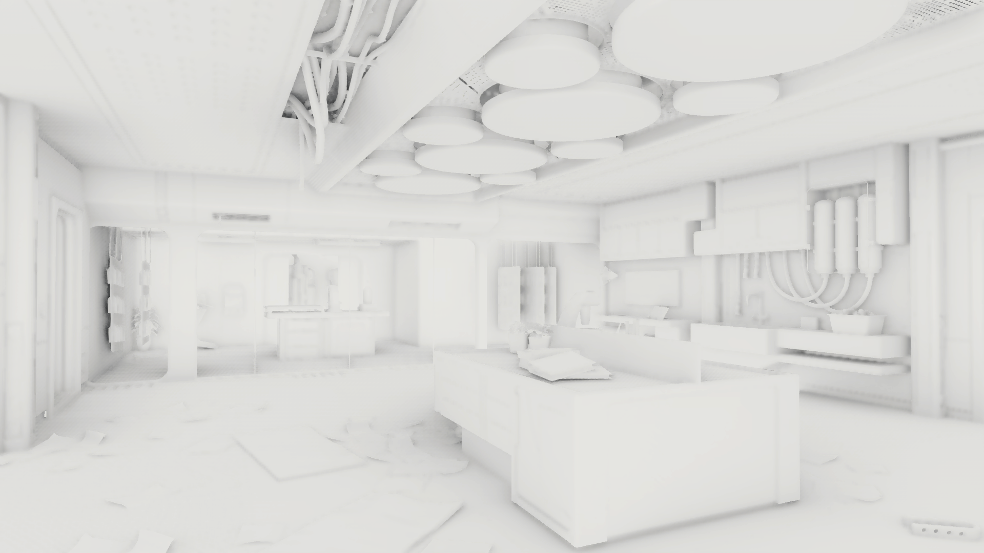
© 2015 Activision Publishing, Inc.
Notes:
Here you can see the ambient occlusion of this scene.

Slide 18
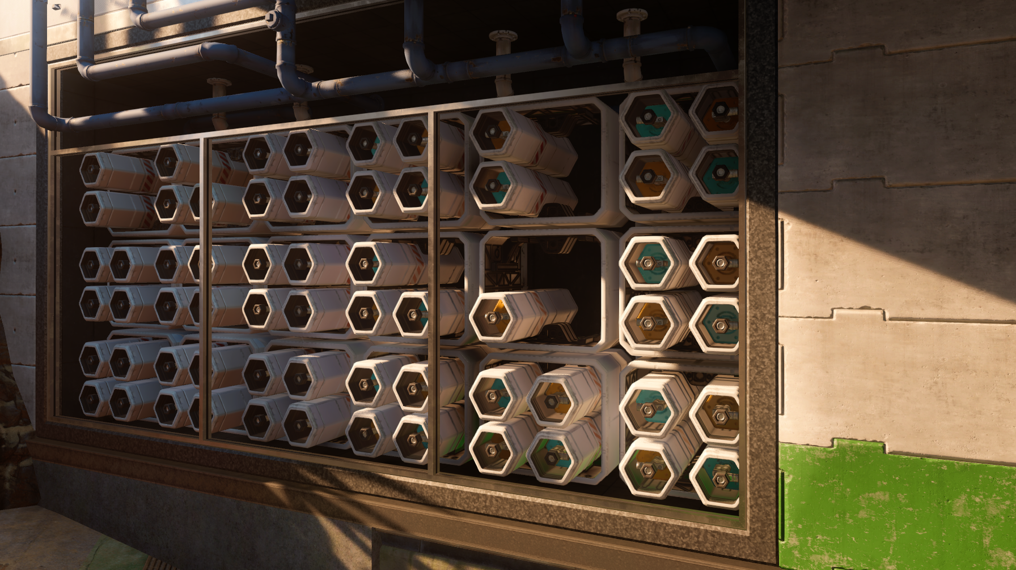
© 2015 Activision Publishing, Inc.
Notes:
This is another shot, without ambient occlusion…

Slide 19
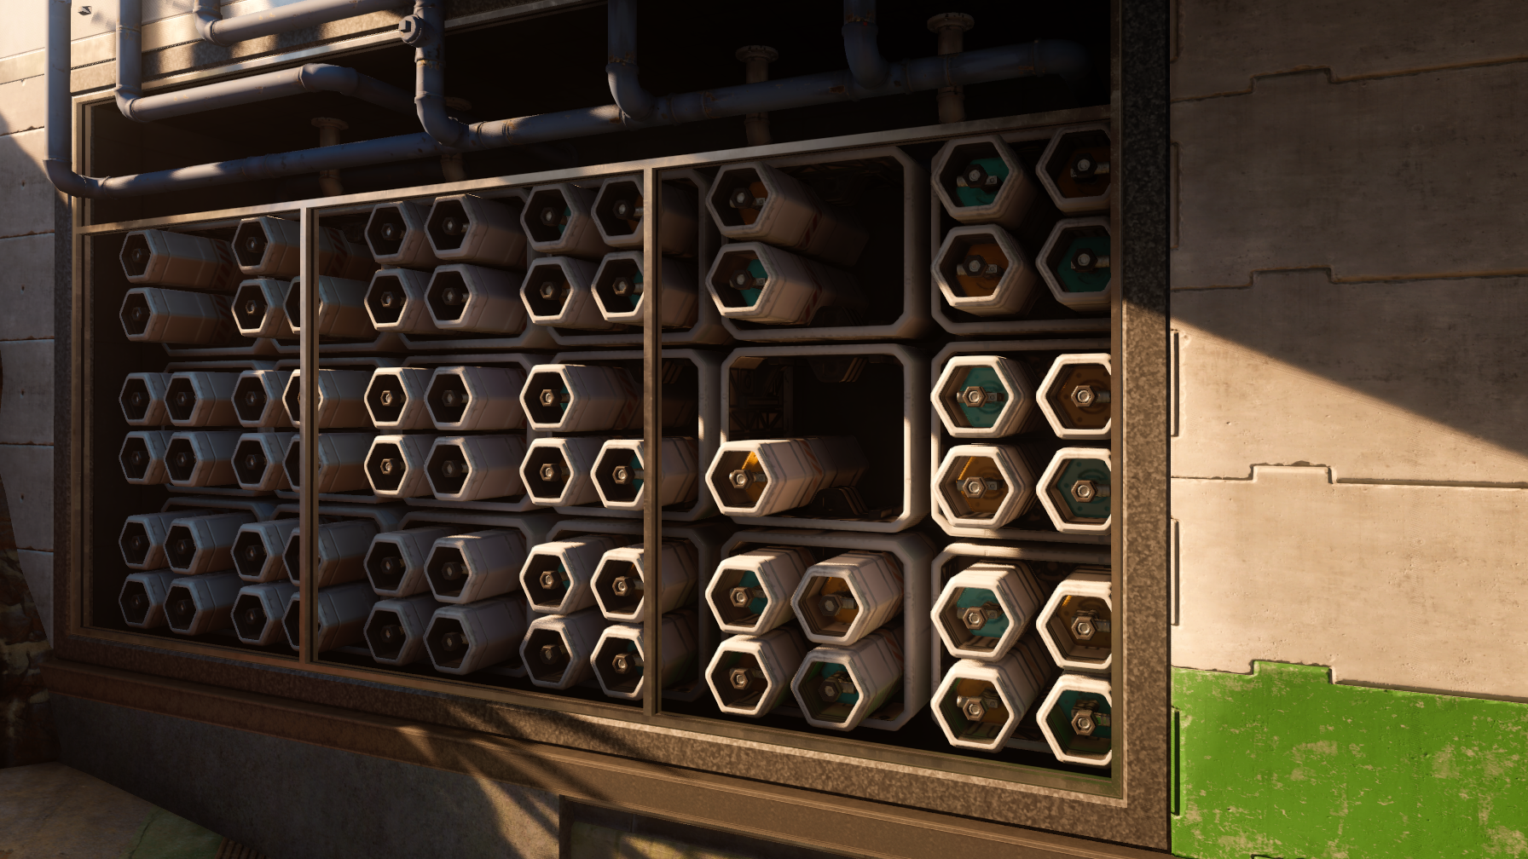
© 2015 Activision Publishing, Inc.
Notes:
…and with GTAO.
Notice how our technique is not shy of darkening where it needs to be darkened.

Slide 20
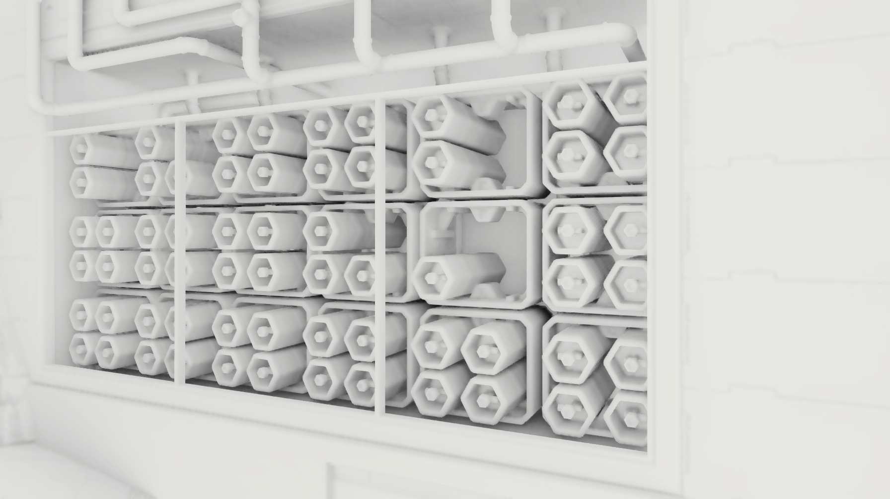
© 2015 Activision Publishing, Inc.

Slide 21
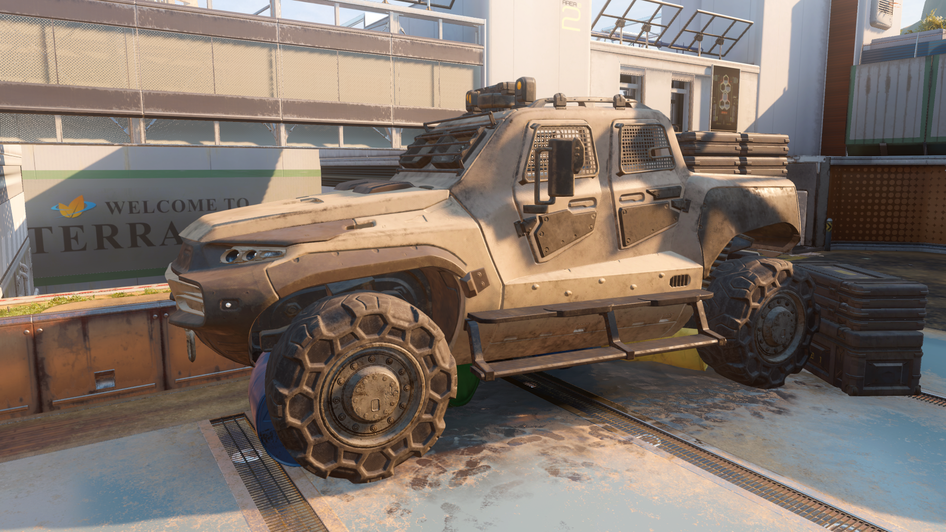
© 2015 Activision Publishing, Inc.
Notes:
And a final example without occlusion…

Slide 22
© 2015 Activision Publishing, Inc.
Notes:
…and with GTAO

Slide 23
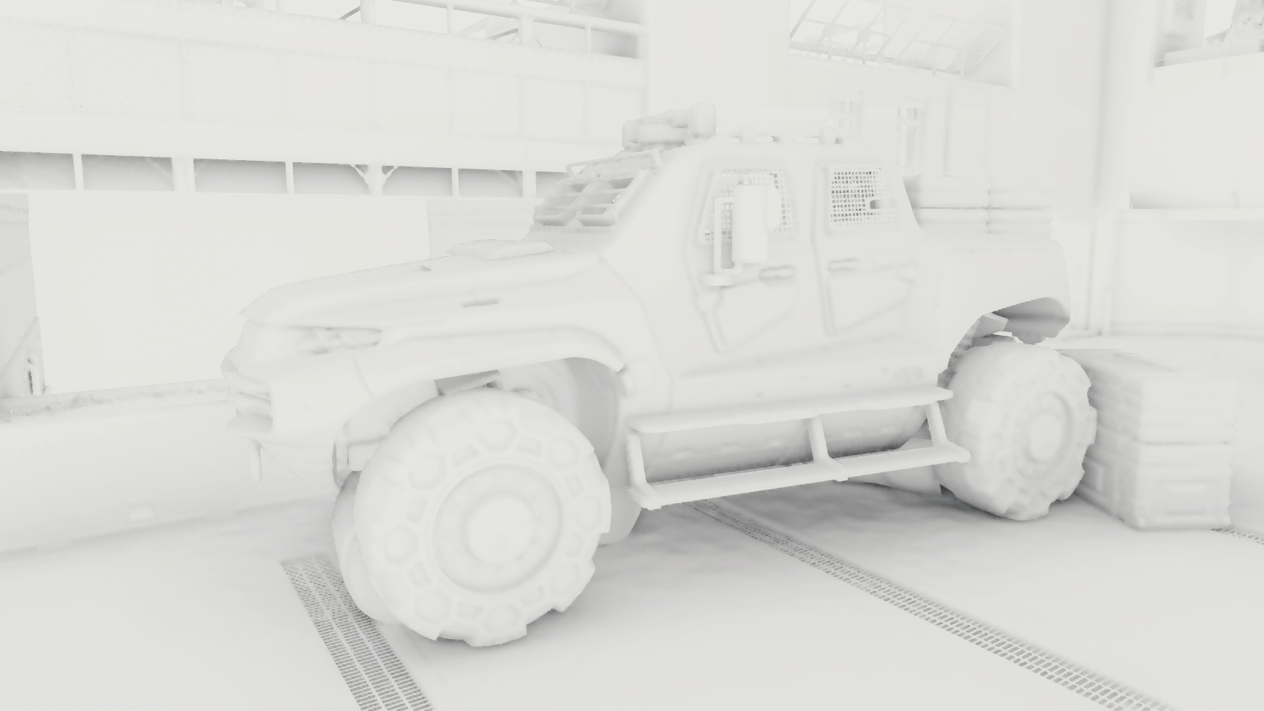
© 2015 Activision Publishing, Inc.

Slide 24
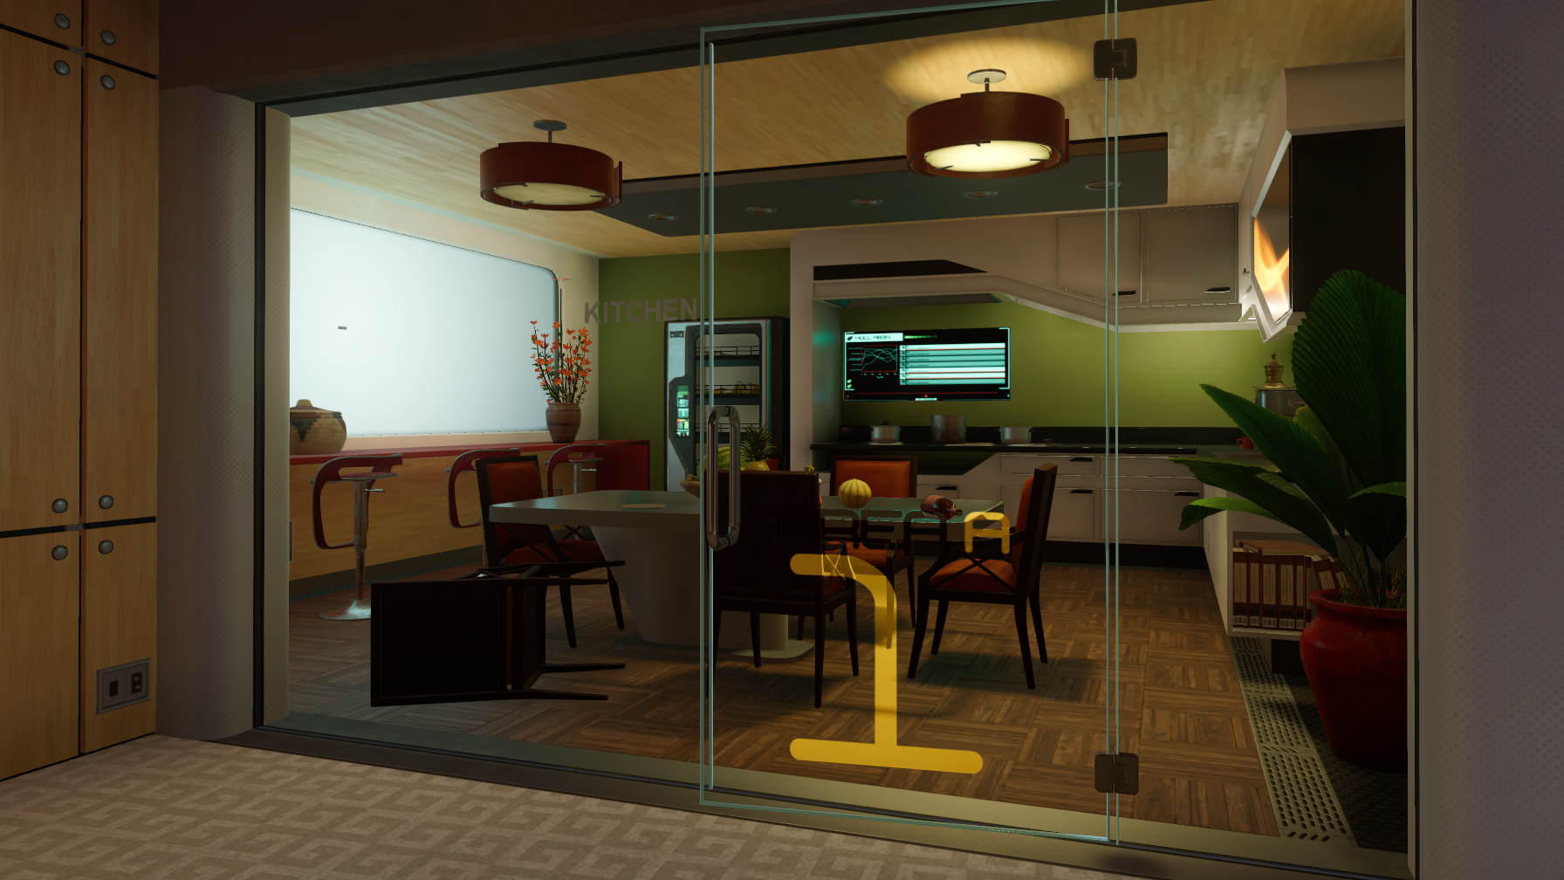
© 2015 Activision Publishing, Inc.

Slide 25
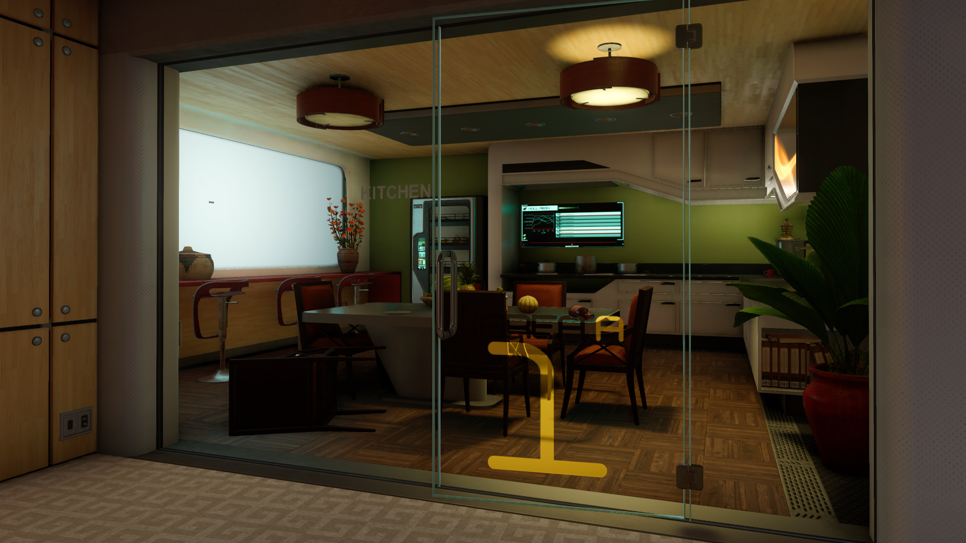
© 2015 Activision Publishing, Inc.

Slide 26
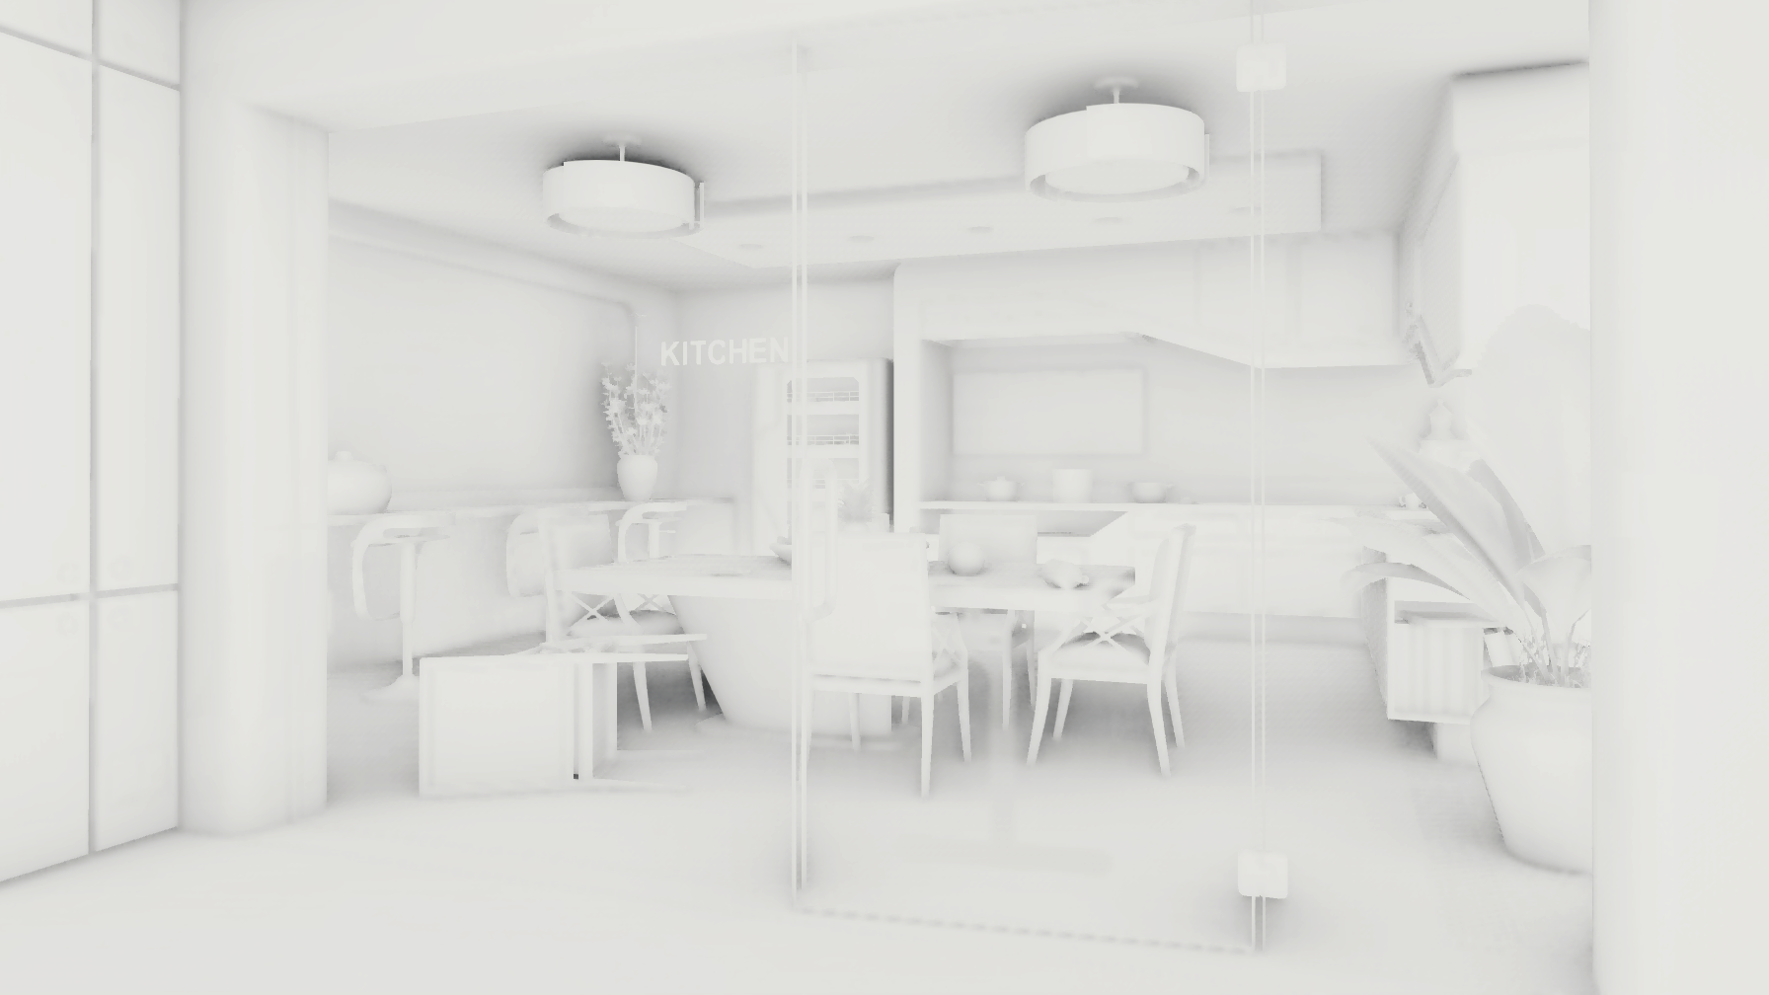
© 2015 Activision Publishing, Inc.

Slide 27
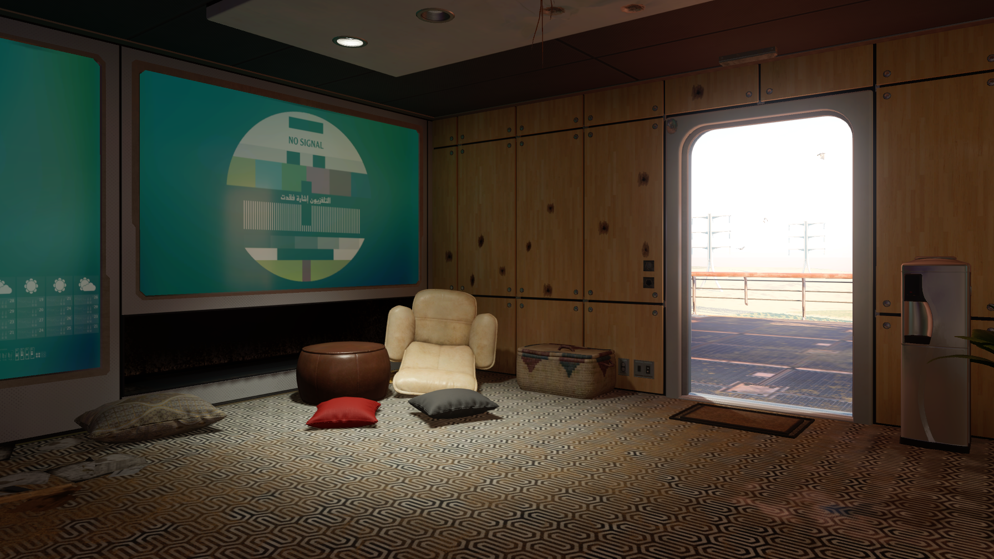
© 2015 Activision Publishing, Inc.

Slide 28
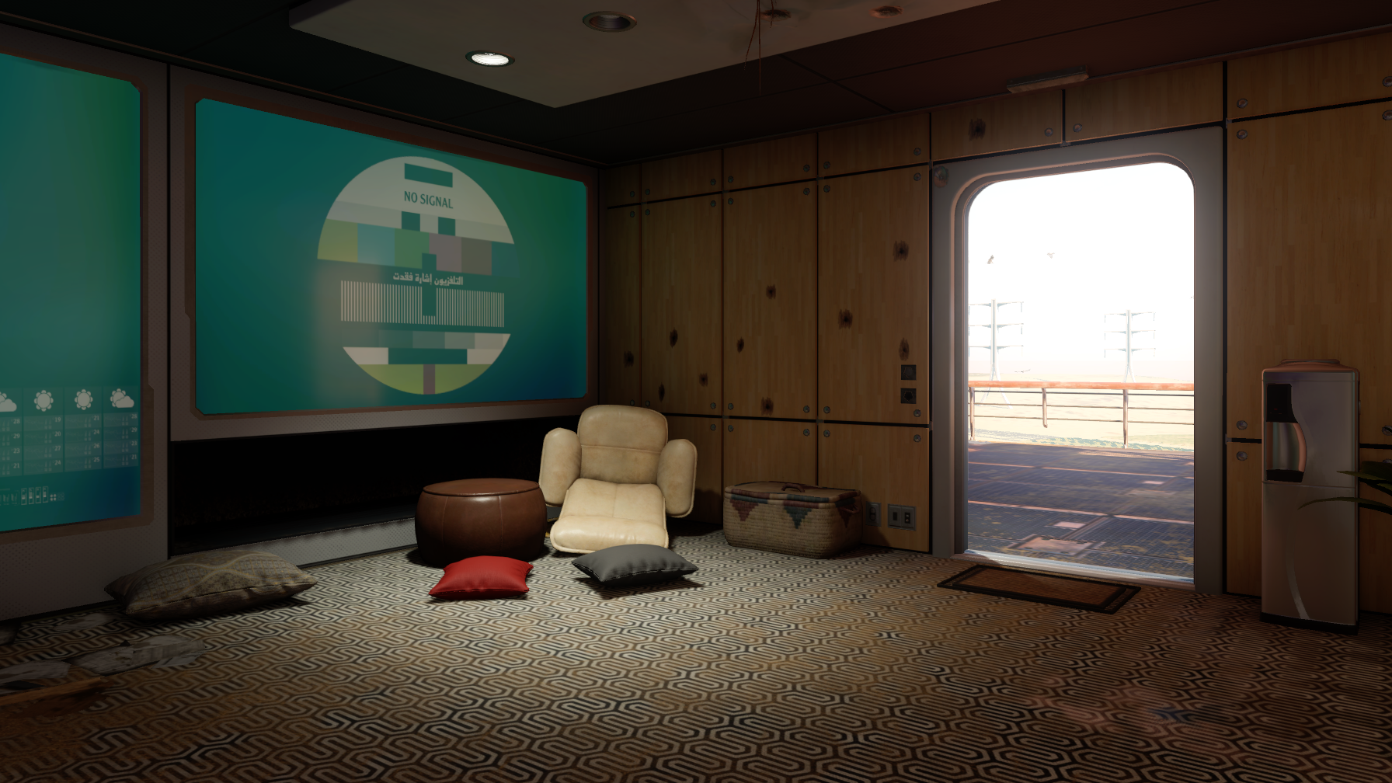
© 2015 Activision Publishing, Inc.

Slide 29
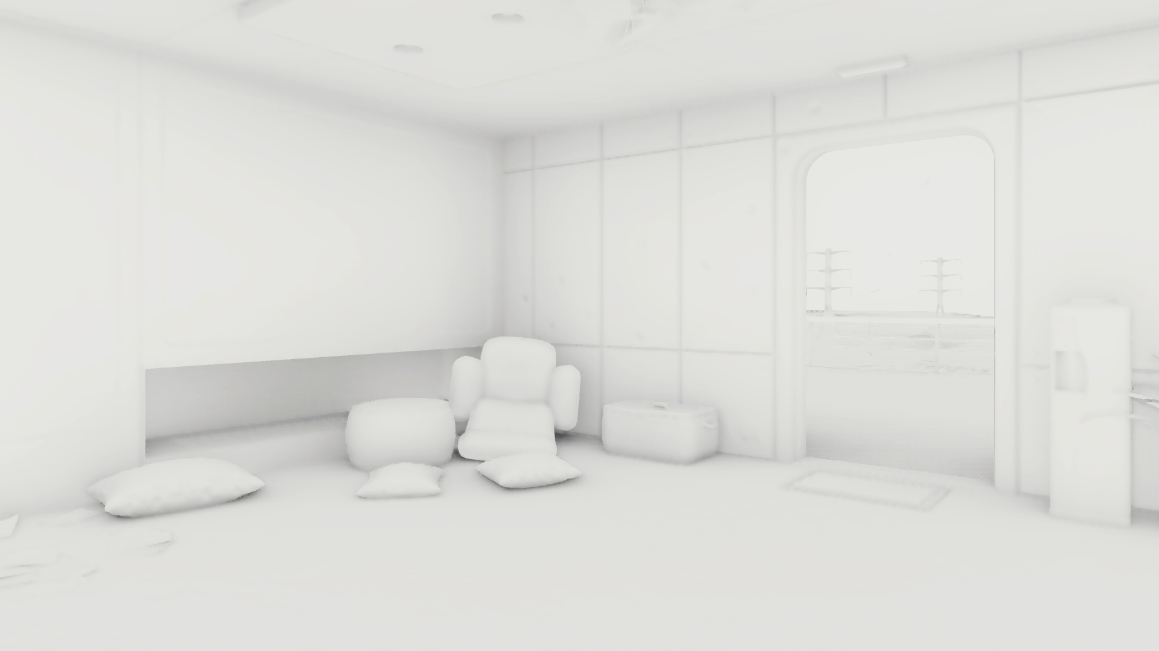
© 2015 Activision Publishing, Inc.

Slide 30
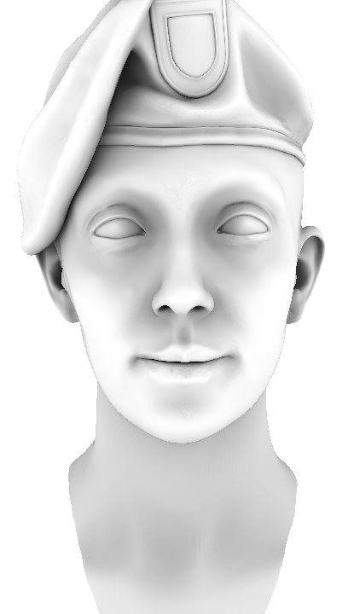
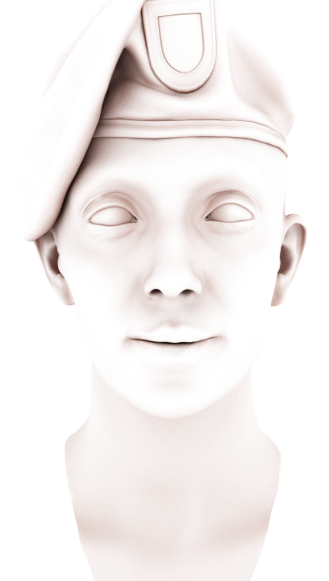
Towards Monte Carlo Ground Truth
$$V_{d}=L_{o}\left(x, ω_{o}\right)/{\text{ρ}}_{d}$$
HBAO
[Bavoil2008]
Monte Carlo
Ground Truth
Notes:
I’ll start with a teaser of what will be presented.
On the left, we have uniform weighting ambient occlusion, which is what we often use.
We will show our journey from this, towards achieving a close match to the occlusion in a Monte Carlo rendering with multiple light bounces, which is on the right.
Notice how different they look.
So, we want to go further than the classic occlusion equation, and attempt to match real lighting occlusion instead.

Slide 31
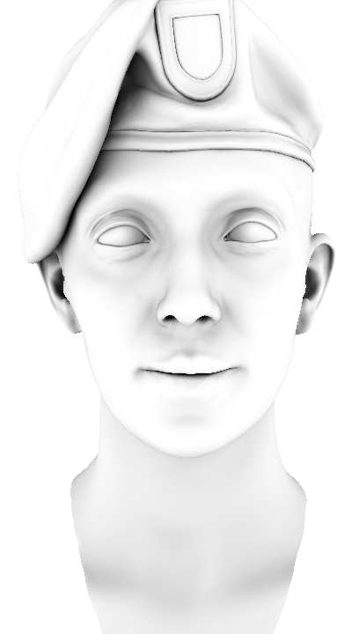
Towards Monte Carlo Ground Truth
$$V_{d}=L_{o}\left(x, ω_{o}\right)/{\text{ρ}}_{d}$$
HBAO
[Bavoil2008]
GTAO
Cosine
Monte Carlo
Ground Truth
Notes:
We will show how to add the cosine term to horizon-based ambient occlusion…

Slide 32
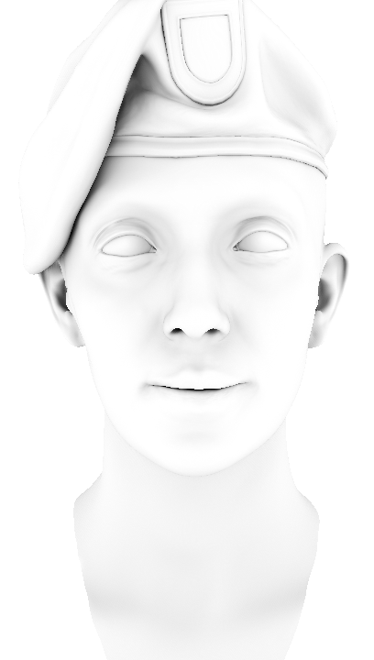
Towards Monte Carlo Ground Truth
$$V_{d}=L_{o}\left(x, ω_{o}\right)/{\text{ρ}}_{d}$$
HBAO
[Bavoil2008]
GTAO
Cosine
GTAO
Cosine + Multi Bounce
Monte Carlo
Ground Truth
Notes:
…and we will show what happens when we consider more than a single bounce of light…

Slide 33
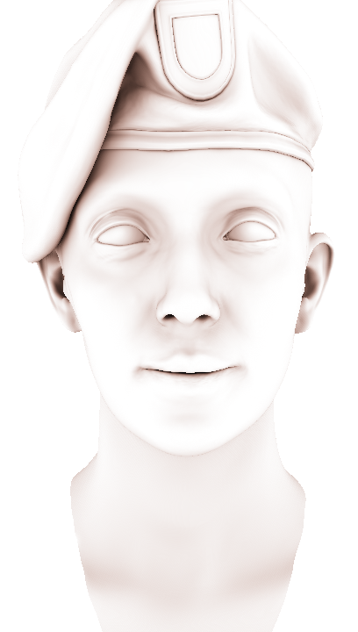
Towards Monte Carlo Ground Truth
$$V_{d}=L_{o}\left(x, ω_{o}\right)/{\text{ρ}}_{d}$$
HBAO
[Bavoil2008]
GTAO
Cosine
GTAO
Cosine + Multi Bounce
GTAO
Cosine + Colored Multi Bounce
Monte Carlo
Ground Truth
Notes:
…and the extension for colored objects.
Here we can see that our final solution, marked in orange,
is a close match for the Monte Carlo reference.

Slide 34
What Is Ambient Occlusion?
$$L_{o}\left(ω_{o}\right)=L_{e}\left(ω_{o}\right)+\int_{Ω}{f_{r}\left(ω_{i},ω_{o}\right)}L_{i}\left(ω_{i}\right)\left(n{∙ω}_{i}\right)dω_{i}$$
Emitted
radiance
BRDF
Incoming
Radiance
Notes:
I’d like to start with the core or basics of our technique, and then show how we improved on that.
So for that, we need to define, what is ambient occlusion?
Let’s start with the rendering equation, where you can see the emitted and incoming radiance and the BRDF.
If we assume there is no emission, and we use the Lambertian BRDF…

Slide 35
What Is Ambient Occlusion?
$$L_{o}\left(ω_{o}\right)=0+\int_{Ω}{\frac{{\text{ρ}}_{d}}{π}}L_{i}\left(ω_{i}\right)\left(n{∙ω}_{i}\right)dω_{i}$$
Incoming
Radiance
Emitted
radiance
BRDF
Notes:
…we get this.
If we then assume a constant white dome is illuminating the scene, and we only calculate a single bounce of light…

Slide 36
What Is Ambient Occlusion?
$$L_{o}\left(ω_{o}\right)=\int_{Ω}{\frac{{\text{ρ}}_{d}}{π}}V\left(ω_{i}\right)1\left(n{∙ω}_{i}\right)dω_{i}$$
White Dome
Visibility
$$V\left(ω_{i}\right)=\left\{\begin{aligned}1 if ω_{i} hits the sky \\ 0 if ω_{i} do not hit the sky\end{aligned}\right.$$
Notes:
…we obtain this.
Notice a new visibility term appeared, that specifies if a ray hits the sky or not.
Then if we rearrange the terms…

Slide 37
What Is Ambient Occlusion?
Ambient occlusion is the ground truth lighting for the case of:
Lambertian surface
White dome (or uniform)
Single bounce of light
$$L_{o}\left(ω_{o}\right)={\text{ρ}}_{d}\frac{1}{π}\int_{Ω}{V(ω_{i})\left(n{∙ω}_{i}\right)dω_{i}}={\text{ρ}}_{d}V_{d}$$
Ambient Occlusion
Notes:
…we arrive to the classic definition of ambient occlusion.
So, we can say that the ambient occlusion multiplied by the albedo is the lighting for the case of:
a white dome,
a single bounce of light and
a Lambertian surface.

Slide 38
How We Use Ambient Occlusion
$$L_{o}\left(ω_{o}\right)={\text{ρ}}_{d}V_{d}\int_{Ω}{L_{i}^{env}\left(ω_{i}\right)\left(n{∙ω}_{i}\right)dω_{i}}$$
Ambient Occlusion
Pre-convolved Probe
Notes:
In real scenes though we don’t typically have uniform white lighting.
The typical approach to account for this is to just multiply the ambient occlusion by the pre-convolved probe,
which will still be accurate for the case of a white dome, but not for any other scenario.

Slide 39
Problem Statement
Cosine-Weighted Ambient Occlusion:
$$V_{d}^{cosine}=\frac{1}{π}\int_{Ω}{V(ω_{i})\left(n{∙ω}_{i}\right)dω_{i}}$$
Uniformly-weighted Ambient Occlusion:
$$V_{d}^{uniform}=\frac{1}{2π}\int_{Ω}{V(ω_{i}) dω_{i}}$$
Cosine Term
Notes:
So, now that we have defined what is ambient occlusion, let’s continue with the problem statement.
We want to find a solution to the ambient occlusion equation, which in simple terms is just the visible area of the hemisphere,
weighted by a cosine term modelling the foreshortening.
Sometimes, ambient occlusion is solved with uniform weighting…

Slide 40
Problem Statement
Cosine-Weighted Ambient Occlusion:
$$V_{d}^{cosine}=\frac{1}{π}\int_{Ω}{V(ω_{i})\left(n{∙ω}_{i}\right)dω_{i}}$$
Uniformly-Weighted Ambient Occlusion:
$$V_{d}^{uniform}=\frac{1}{2π}\int_{Ω}{V(ω_{i}) dω_{i}}$$
Notes:
...which unfortunately doesn’t yield ground truth results for the assumptions we made, so we won’t use it here.

Slide 41
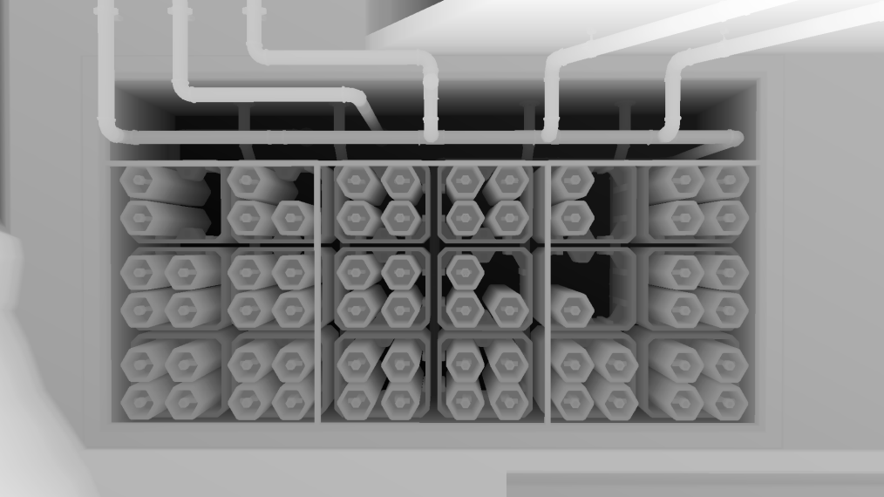
Input Data
Visibility function
Depth buffer (height field)
Surface normal
Normal buffer, or
Derived from depth buffer
Notes:
This is the input data that we have.
The surface normal, which can either come from a normal buffer or derived from the depth buffer.
And the visibility function, which in our case comes from a depth buffer given that we work in screen space.
This means that the scene is represented as an height field, and as we’ll see later on, this is a very important observation.

Slide 42
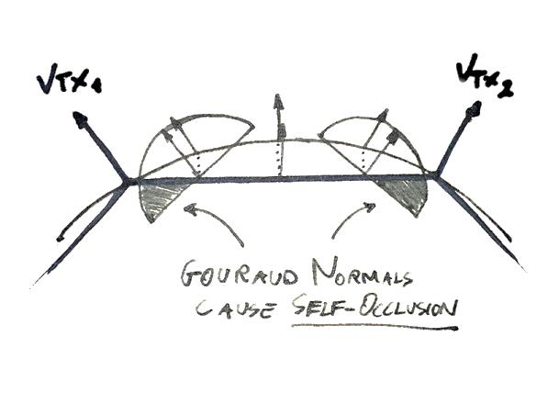
Which Normals?
Shading
Gouraud & Normal-Maps
Geometric
Can be approximated via z-buffer differentials
No perfect solution
Gouraud interpolation causes erroneous self-occlusion
Normals don’t belong to the actual surface
Normal-Maps could be desirable
Often easier/best to bake their occlusion in the surface (not if tiling/compositing)
Be sure not to double-occlude (in the maps and in the SSAO)
Geometric normals can make the faceted nature of the mesh visible
As hemisphere orientation “snaps” sharply when moving from triangle to triangle
This problem affects Monte-Carlo path tracing as well

Slide 43
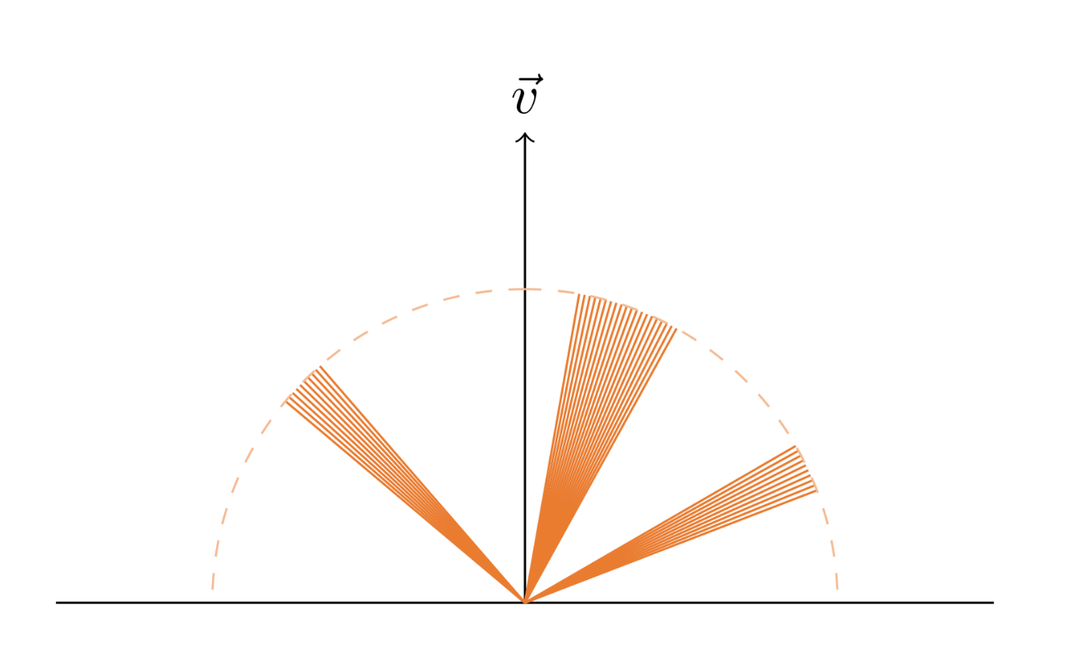
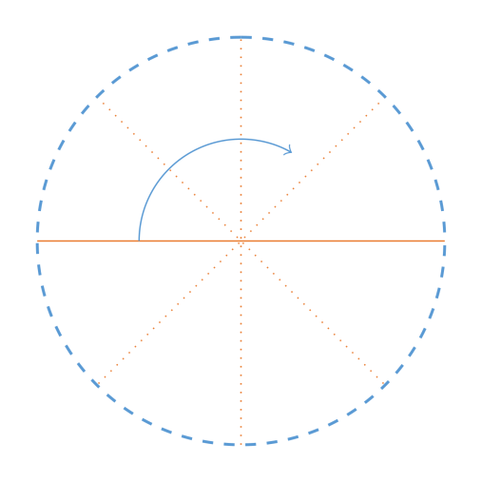
Double Integral
$$V_{d}=\frac{1}{π}\int_{Ω}{V(ω_{i})\left(n{∙ω}_{i}\right)dω_{i}}=\frac{1}{π}\int_{0}^{π}{\int_{{−π}/2}^{π/2}{V\left(θ,φ\right)\left(n{∙ω}_{i}\right)\left|\sin\left(θ\right)\right| dθ}dφ}$$
Occluded
Slice
Occluded
Occluded
Side View (Slice)
Front View
Notes:
We can calculate the ambient occlusion integral as a double integral in polar coordinates.
The inner integral integrates the visibility for a slice of the hemisphere, as you can see in the left,
and the outer integral swipes this slice to cover the full hemisphere.
The simplest solution would be to just numerically solve both integrals.
But the solution we chosen, horizon-based ambient occlusion, which was introduced by Louis Bavoil in 2008,
made the key observation that the occlusion as pictured here can’t happen when working with height fields.
Using height-fields we would never be able to tell that the areas in…

Slide 44
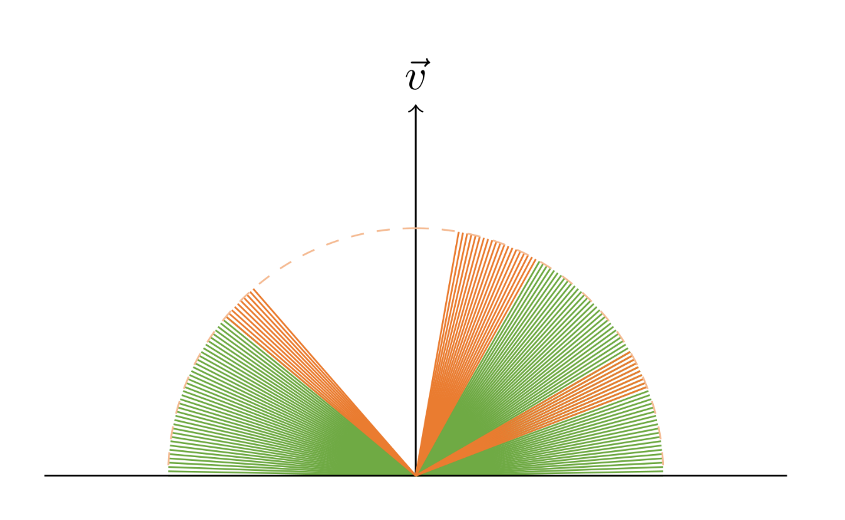
Horizon-Based Ambient Occlusion [Bavoil2008]
$$V_{d}=\frac{1}{π}\int_{Ω}{V(ω_{i})\left(n{∙ω}_{i}\right)dω_{i}}=\frac{1}{π}\int_{0}^{π}{\int_{{−π}/2}^{π/2}{V\left(θ,φ\right)\left(n{∙ω}_{i}\right)\left|\sin\left(θ\right)\right| dθ}dφ}$$
Occluded
Slice
Occluded
Occluded
Side View (Slice)
Front View
Notes:
…green here, are actually visible.
The key consequence of this, is that we can just search for the two horizons h1 and h2…

Slide 45
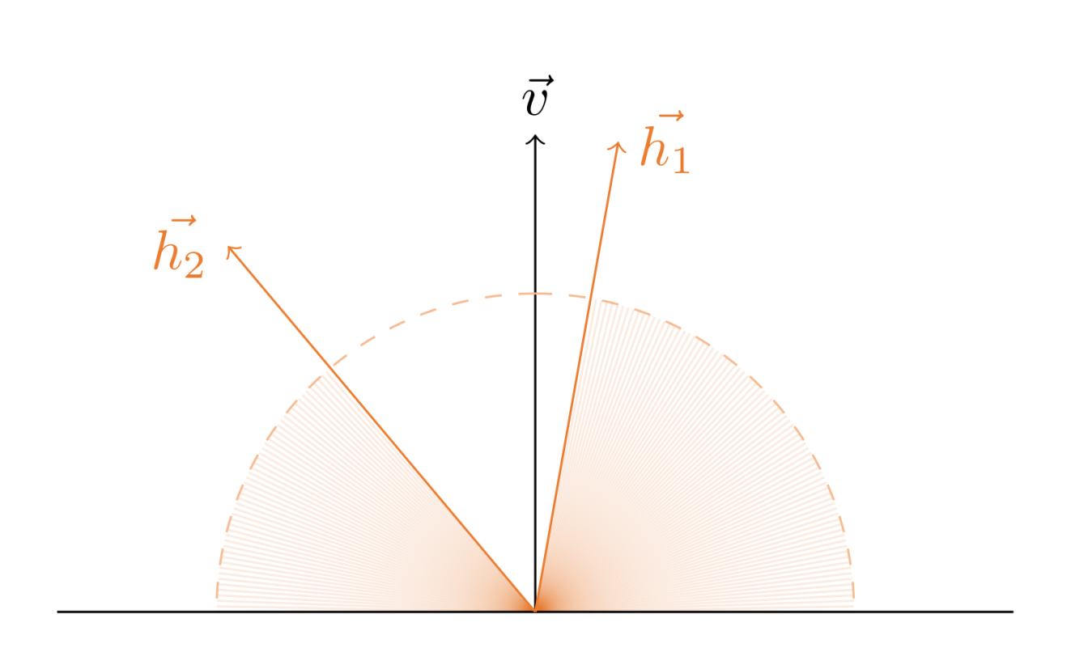
Horizon-Based Ambient Occlusion [Bavoil2008]
$$V_{d}=\frac{1}{π}\int_{Ω}{V(ω_{i})\left(n{∙ω}_{i}\right)dω_{i}}=\frac{1}{π}\int_{0}^{π}{\int_{{−π}/2}^{π/2}{V\left(θ,φ\right)\left(n{∙ω}_{i}\right)\left|\sin\left(θ\right)\right| dθ}dφ}$$
Slice
Side View (Slice)
Front View
Notes:
…and that captures all the visibility information that can be extracted from a height map,
for a given slice.
So, with this information at hand, we no longer need to calculate both integrals numerically…

Slide 46
Horizon-Based Ambient Occlusion [Bavoil2008]
$$V_{d}=\frac{1}{π}\int_{Ω}{V(ω_{i})\left(n{∙ω}_{i}\right)dω_{i}}=\frac{1}{π}\int_{0}^{π}{\int_{{−π}/2}^{π/2}{V\left(θ,φ\right)\left(n{∙ω}_{i}\right)\left|\sin\left(θ\right)\right| dθ}dφ}$$
Analytic solution per slice
Numerical integral on the longitude
Slice
Side View (Slice)
Front View
Notes:
…and can instead perform the inner integral, in orange, analytically,
which is substantially faster.
The original horizon-based ambient occlusion technique used uniform weighting,
so this means that we need to figure out how to do this analytical integral for the cosine weighting case.

Slide 47
Horizon-Based Ambient Occlusion [Bavoil2008]
Discrete data ⟶ Not fully closed-form
Depth buffer ⟶ Single visibility aperture
We only see the visibility by tracing the depth buffer
Depth buffer considered by SSAO algorithms to be a height field
Horizon model [Bavoil2008] is the best we can do!
Compute the occluded angles of each longitudinal slice
Compute the AO integral in the unoccluded area
$$h_{1}$$
$$h_{2}$$

Slide 48
Searching for Horizons
Side View (Slice)

Slide 49
Searching for Horizons
Side View (Slice)

Slide 50
Searching for Horizons
Side View (Slice)

Slide 51
Searching for Horizons
Side View (Slice)

Slide 52
Searching for Horizons
Side View (Slice)

Slide 53
Searching for Horizons
Side View (Slice)

Slide 54
Method
For each direction, calculate the horizons $h_{1}$ and $h_{2}$:
$$h_{1}=−\operatorname{acos}\left( \max_{s = 1 … m/2}\left({ \vec{d_{s}}∙\vec{v}}/{\left|\vec{d_{s}}\right|} \right) \right)$$
$$h_{2}=+\operatorname{acos}\left( \max_{t = 1 … m/2}\left({ \vec{d_{t}}∙\vec{v}}/{\left|\vec{d_{t}}\right|} \right) \right)$$
$$\vec{d_{s}}=\vec{p_{s}}−\vec{p_{c}}$$
$$\vec{d_{t}}=\vec{p_{t}}−\vec{p_{c}}$$
Notes:
$\vec{p_{s}}$ and $\vec{p_{c}}$: sample and center positions in view space
$\vec{v}=−\vec{p_{c}}$: view vector
$m$: sample count
In this diagram, $\vec{d_{s}}$ samples to the left and $\vec{d_{t}}$ to the right.

Slide 55
Method
Calculate the visibility $v_{d}$ for this slice:
$$v_{d}=IntegrateArc\left(h_{1},h_{2}\right)$$

Slide 56
Method
Slightly different from HBAO:
No sample attenuation (obscurance)
Can’t match ground truth renderings if we use obscurance
One integral per direction rather than per sample (reduces ALU overhead)
We still do conservative attenuation (more details later on)
Instead of using obscurance to avoid the overdarkening produced by ignoring near-field interreflections, we add this lost light (more details later on)
Not using attenuation allows to integrate with respect to the view vector $\vec{v}$ rather than the XY plane
We integrate from $\vec{v}$ to horizon instead of integrating from XY to horizon and from XY to tangent (halves number of integrals)
Simple search loop (dot, rsqrt and max)
Shader becomes completely memory bound
Aiming for ground truth calculations becomes free (we do optimal math with a given sample set)
Integrates 180° slices instead of 90° ones
Reduces ALU overhead by sharing calculations
HBAO is mathematically equivalent to our method (with uniform weighting) if no obscurance is used

Slide 57
NVIDIA’s HBAO Implementation
Contains a performance optimization that prevents to reproduce the results shown in this presentation:
Compute shader version does further optimizations that bias the results
Pixel shader one is the recommended for visual reference
Note that HBAO+ is the latest implementation and seems to not be horizon based
data.MaxRadiusPixels = 0.1f * min(data.FullResolution[0], data.FullResolution[1]);
data.MaxRadiusPixels = 300.0f;

Slide 58
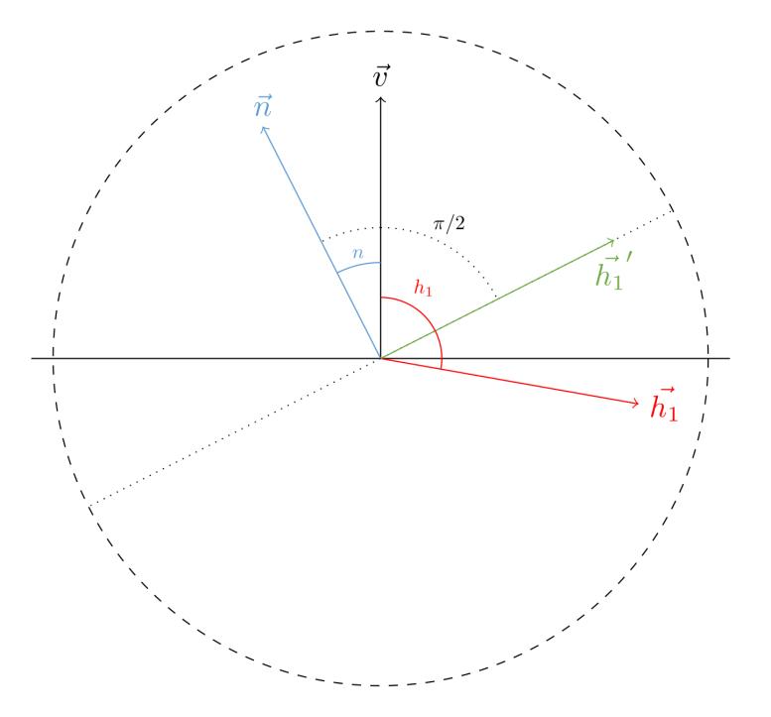
Integration Domain
Note: $h_{1}$ is negative
$$h_{1}′ = n+max⁡(h_{1}−n, −π/2)$$
$$h_{2}′ = n+min⁡(h_{2}−n, π/2)$$
We (have to) slice in screen-space circles
The spherical integral axis is the view-vector
We search for horizons in the full sphere
The horizons can be in the negative view hemisphere ($h_{1}$)
We have to clamp them with the normal hemisphere ($h_{1}′$)

Slide 59
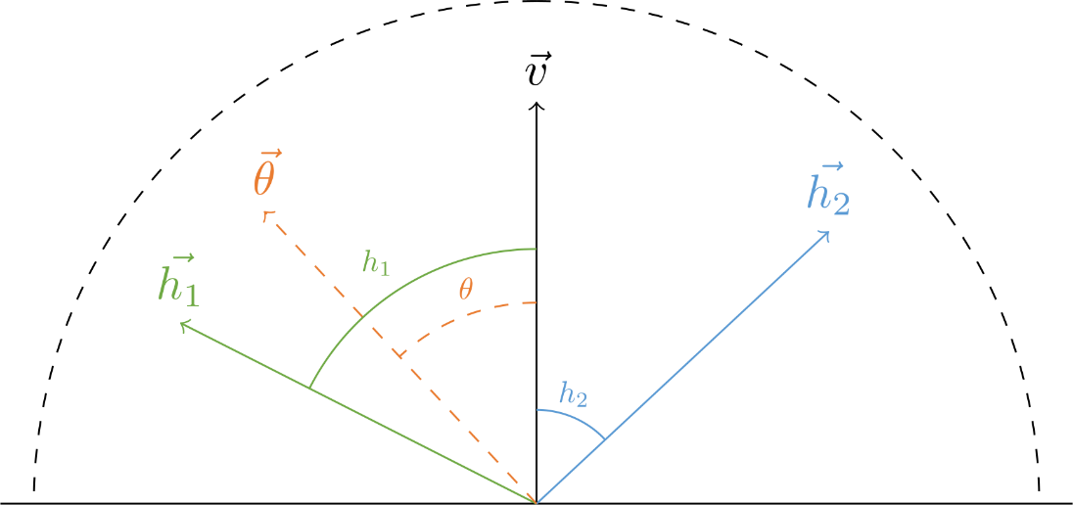
Uniform Weighting
Ambient occlusion equation:
$$V_{d}^{uniform}=\frac{1}{2π}\int_{0}^{π}{\int_{{−π}/2}^{π/2}{V\left(θ,φ\right)\left|\sin\left(θ\right)\right| dθ}dφ}$$
Using horizon angles $h_{1}$ and $h_{2}$, we have the visibility for a single slice $v_{d}$:
$$v_{d}=IntegrateArc\left(h_{1},h_{2}\right)=$$
$$\int_{0}^{h_{1}}{\left|\sin\left(θ\right)\right|}dθ+\int_{0}^{h_{2}}{\left|\sin\left(θ\right)\right|}dθ=$$
$$\left(1−\cos\left(h_{1}\right)\right)+(1 −{cos(h}_{2}))$$
$$v_{d}$$

Slide 60
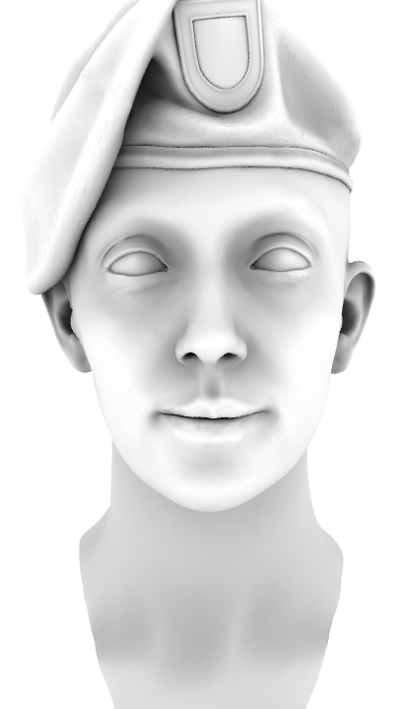
Monte Carlo Ground Truth
GTAO
Uniform

Slide 61
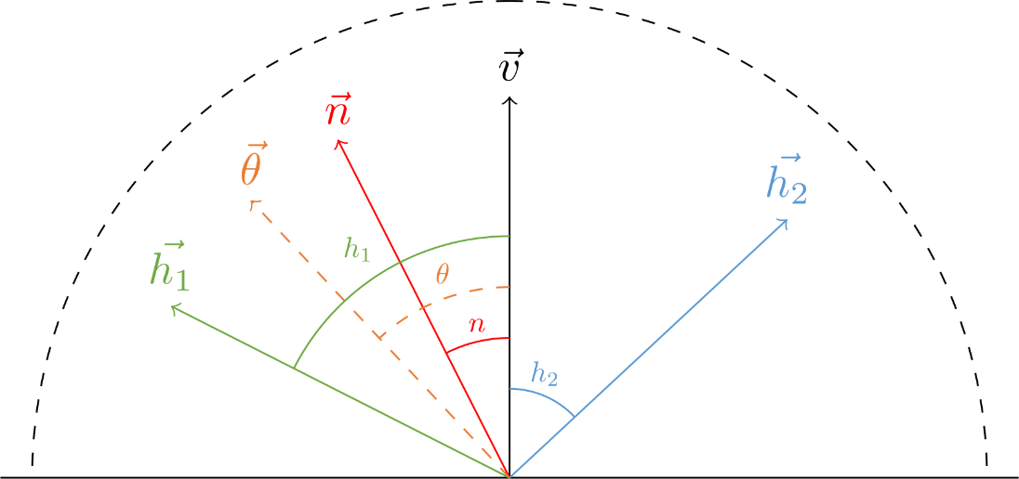
Cosine Weighting
Ambient occlusion equation:
$$V_{d}^{cosine}=\frac{1}{π}\int_{0}^{π}{\int_{{−π}/2}^{π/2}{V\left(θ,φ\right)\cos\left(θ−n\right)\left|\sin\left(θ\right)\right| dθ}dφ}$$
Using horizon angles $h_{1}$ and $h_{2}$, we have the visibility for a single slice $v_{d}$:
$$v_{d}=IntegrateArc\left(h_{1},h_{2}, n\right)=$$
$$\int_{0}^{h_{1}}{cos(θ−n)\left|\sin\left(θ\right)\right|}dθ+\int_{0}^{h_{2}}{cos⁡(θ−n)\left|\sin\left(θ\right)\right|}dθ=$$
$$\frac{1}{4}\left(−\cos\left(2h_{1}−n\right)+\cos\left(n\right)+2h_{1}\sin\left(n\right)\right)+\frac{1}{4}\left(−\cos\left(2h_{2}−n\right)+\cos\left(n\right)+2h_{2}sin⁡(n)\right)$$
$$v_{d}$$
Notes:
To solve ambient occlusion with cosine weighting,
we integrate the visibility from the view vector to h1, marked in green,
and the visibility from the view vector to h2, marked in blue,
taking the cosine term into account, marked in purple on the equation.
It is a bit more involved than this, but I’ll leave the details to the technical report and the online slides.
[Note: here $v_{d}$ and $IntegrateArc$are NOT the same as in the $V_{d}^{uniform}$ case, we just avoided renaming everything with “uniform” and “cosine” not to clutter the equations]

Slide 62
Cosine Weighting Normal Projection
So far, we assumed that normal lies on the sampling slice
[Timonen2013b] showed that:
$$V_{d}^{cosine}=\frac{1}{π}\int_{0}^{π}{\int_{{−π}/2}^{π/2}{V\left(θ,φ\right)\left(\vec{n}∙\vec{θ}\right)\left|\sin\left(θ\right)\right| dθ}dφ}$$
$$V_{d}^{cosine}=\frac{1}{π}\int_{0}^{π}{\left\|\vec{n_{p}}\right\|\int_{{−π}/2}^{π/2}{V\left(θ,φ\right)\left(\frac{\vec{n_{p}}}{\left\|\vec{n_{p}}\right\|}∙\vec{θ}\right)\left|\sin\left(θ\right)\right| dθ}}dφ$$
where $\vec{n_{p}}$ is the normal projected onto the sampling plane
In practical terms:
Project (and normalize) the normal to the slice plane for the integration
Multiply each slice contribution by the length of the projected normal

Slide 63
Cosine Weighting LUT vs Analytical
Cosine weighting already used for horizon-based ambient occlusion [Timonen2013b]
Tabulated LUT solution with per sample attenuation
Analytic solution practical for us
ALU not a problem as we’re memory bound
By design we do not use per sample attenuation
Only one integral per direction instead of per sample
Transcendental functions after optimization:
2 cos and 1 sin
3 acos also needed for setting up the integration domain
Use fast sqrt [Drobot2014a] and acos [Eberly2014]
float GTAOFastSqrt( float x )
{
// [Drobot2014a] Low Level Optimizations for GCN
return asfloat( 0x1FBD1DF5 + ( asint( x ) >> 1 ) );
}
float GTAOFastAcos( float x )
{
// [Eberly2014] GPGPU Programming for Games and Science
float res = -0.156583 * abs( x ) + GTAO_PI / 2.0;
res *= GTAOFastSqrt( 1.0 - abs( x ) );
return x >= 0 ? res : GTAO_PI - res;
}

Slide 64
Possible Pitfall
Using:
$$\int_{{−π}/2}^{π/2}{V(θ,φ)cos(n)\left|\sin\left(n\right)\right|}dθ$$
Instead of:
$$\int_{{−π}/2}^{π/2}{V\left(θ,φ\right)cos\left(n\right)\left|\sin\left(θ\right)\right| dθ}$$
Why not?
We search for horizons on the whole sphere
$\sin\left(θ\right)$ ensures regular sampling in the view-space hemisphere
$cos(n)$ due to the cosine weighting (obviously) done with respect to the normal angle $n$

Slide 65
Monte Carlo Ground Truth
GTAO
Cosine
Notes:
In this slide we have a comparison of the ground truth
and our results so far.
So, we have done a quick recap of how to efficiently calculate the integral using horizon-based ambient occlusion,
and then we have shown how to take the cosine term into account.

Slide 66
Multiple Bounces
Ambient occlusion is the ground truth lighting for the case of:
Lambertian surface
White dome (or uniform)
Single bounce of light
Notes:
Now, to move this forward, we will relax the assumption of using a single bounce of light…

Slide 67
Relaxing the Assumptions
Ambient occlusion is the ground truth lighting for the case of:
Lambertian surface
White dome (or uniform)
Single bounce of light
Extend the regular ambient occlusion equation by relaxing the assumptions:
Lambertian surface
White dome (or uniform)
Neighboring albedos${\text{ρ}}_{m}≈$ the albedo ${\text{ρ}}_{1}$ of current point being shaded
Allows to approximate multiple bounces
[Silvennoinen2015] is an alternative solution using screen space bounces, could not afford due to our limited budget
Notes:
…and replace it with the assumption that the albedo for the point being shaded is similar to that in the close neighborhood.
Doing this allows to approximate multiple bounces of light.

Slide 68
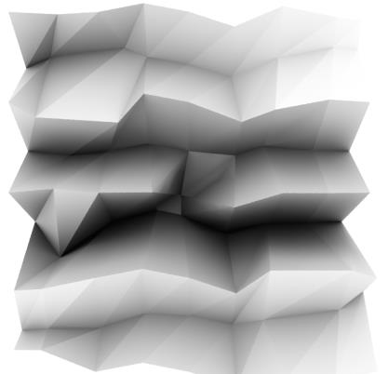
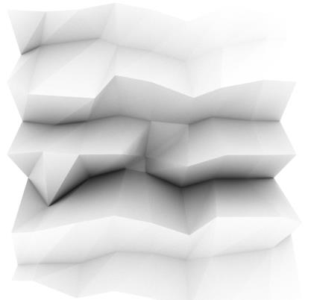
Multiple Bounces
Method:
Calculate single-bounce using Monte Carlo ray tracing:
$$V_{d}$$
Calculate multi-bounce using Monte Carlo ray tracing @ given albedo $\text{ρ}$ (4 bounces):
$$V_{d}^{′}$$
Fit a function $f$ that translates from single to multi-bounce results:
$$V_{d}^{′}=f\left(V_{d},\text{ρ}\right)$$
Single Bounce ($V_{d}$)
Multi Bounce ($V_{d}^{′}$)
Notes:
The high level idea is simple.
We calculate references using single and multi bounce Monte Carlo raytracing, for a given albedo, which is shown in the images on the right.
Now the idea is that we can perhaps fit a function that will map the single-bounce results to the multi-bounce ones.
Note that most previous techniques tried to avoid the overdarkening produced by AO introducing Ambient Obscurance,
which empirically assigns less weight to far away occluders.
We instead try to directly account for the lost energy with a correction function on the AO value,
and derive this function from data.

Slide 69
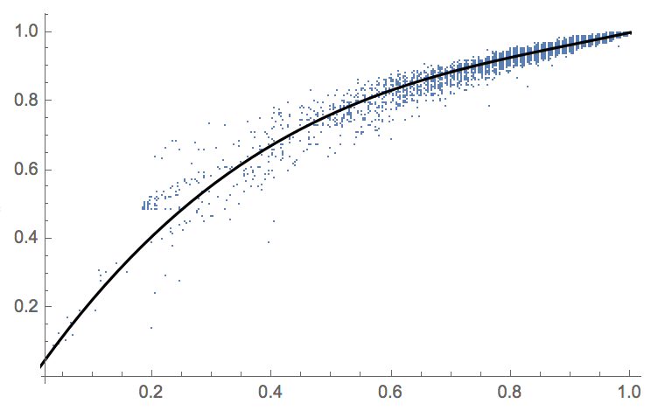
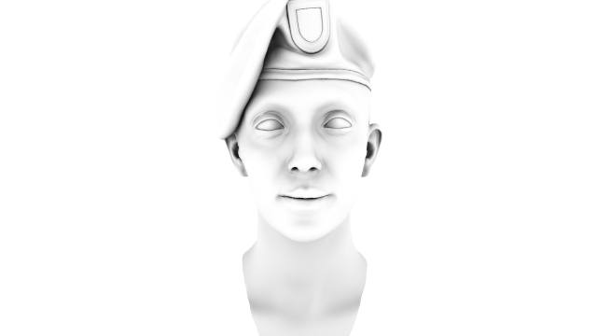
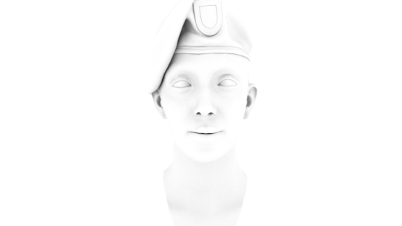
Fitting for a Fixed Albedo
Fitting a brightness remapping curve for an albedo of $\text{ρ}$=0.6
$$f$$
$$V_{d}^{′}$$
$\text{Single} \text{Bounce} (V_{d}$)
$$\text{Multi} \text{Bounce}\text{ (}V_{d}^{′}\text{)}$$
$$V_{d}$$
$V_{d}^{′}=f\left(V_{d}\right)$=$\left(\left(aV_{d}+b\right)V_{d}+c\right)V_{d}$
Notes:
So, we started looking at the data for a given albedo, in this case 0.6.
On the right we have a plot of how intensities in the single bounce image on the horizontal axis,
map to the ones in the multi bounce image on the vertical axis.
For this data, we found that fitting a cubic polynomial function was sufficient to model this correlation.

Slide 70
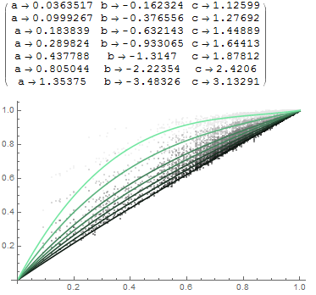
Fitting Over Varying Albedo
Seven single to multi-bounce references, for various albedos $\text{ρ}$
Fit a cubic polynomial per albedo:
$$V_{d}^{′}=\left(\left(aV_{d}+b\right)V_{d}+c\right)V_{d}$$
Cubic Polynomial Coefficients
$$\text{ρ}=0.1$$
$$\text{ρ} =0.4$$
$$V_{d}$$
$$V_{d}^{′}$$
$$\text{ρ}=0.9$$
$$V_{d}^{′}$$
$$\text{ρ}=0.1$$
$$\text{ρ}=0.2$$
$$\text{ρ}=0.3$$
$$\text{ρ}=0.4$$
$$\text{ρ}=0.5$$
$$\text{ρ}=0.7$$
$$\text{ρ}=0.9$$
$$V_{d}$$
Notes:
Then, to generalize to varying albedos, we calculated seven multi-bounce references, for albedos ranging from 0.1 to 0.9.
For each albedo, we calculate its own cubic polynomial fit.
On the right you can see the 7 polynomials, and their coefficients,
and on the plot how the curve changes shape as the albedo increases.

Slide 71
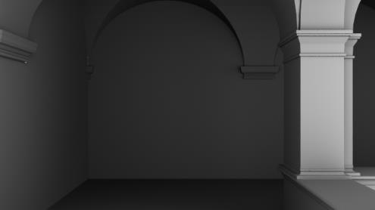
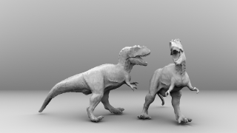
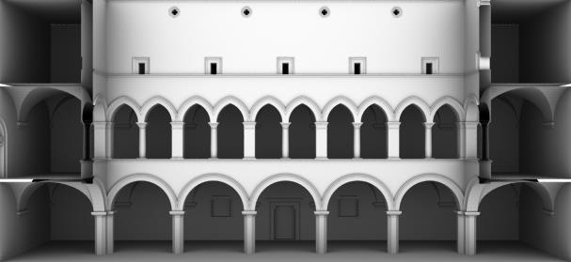
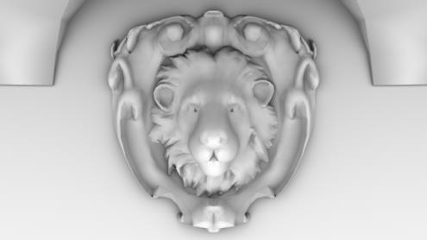
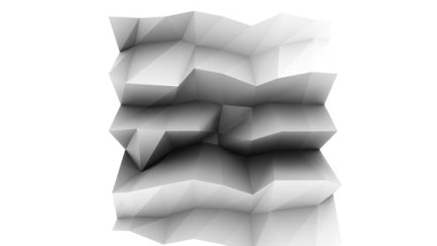
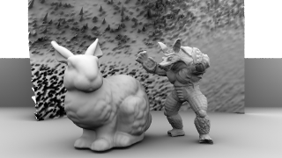
Generalizing to Other Scenes
$$V_{d}$$
(a)
(b)
(c)
(d)
(e)
(f)
(g)
Notes:
We found our fits to work great for our test case, which was a human head.
But we wanted to discover if the technique generalizes to other cases.
Se we prepared a larger dataset and performed fittings for all the scenes shown here.

Slide 72
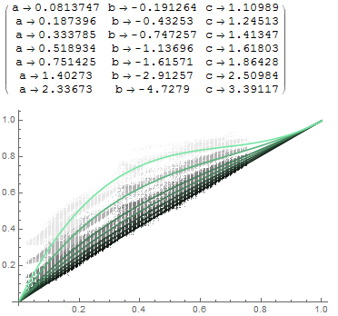
(a)
(b)
(c)
(d)
(e)
(f)
Notes:
You can observe that even if our fitting functions are not exactly the same for all the scenes,
they all look reasonably similar.
Especially for the lower albedos, which are the ones that we more often find in nature.

Slide 73
Final Fit Over All Data
Using all the input data jointly
$$V_{d}^{′}$$
$$V_{d}$$
Notes:
So, using all this data, we did a final fitting and obtained this.
At this point we know how to do the multibounce mapping for the seven albedos that we used for the fitting, but how to generalize to arbitrary ones?

Slide 74
Finding a Symbolic Expression
How to lerp between the fits for each albedo?
For each albedo we have:
$V_{d}^{′}=\left(\left(aV_{d}+b\right)V_{d}+c\right)V_{d}$
A linear function for each coefficient $a$, $b$ and $c$:
$a=a_{0}+a_{1}\text{ρ}$
Coefficient $a$
Coefficient $b$
Coefficient $c$
Notes:
To find out, we plotted the coefficients a, b, c of the cubic polynomial of each albedo that we fitted.
So, in these figures, you have albedo in the horizontal axis, and the coefficient value in the vertical one.
As you can see they are pretty much linear, so we approximated the polynomial coefficients as function of the albedo with linear equations.

Slide 75
Recap
$V_{d}^{′}=f\left(V_{d},\text{ρ}\right)$
Notes:
So, to recap.
We have a function that maps from single bounce AO to multi bounce AO, for a given albedo.

Slide 76
Recap
$V_{d}^{′}=f\left(V_{d},\text{ρ}\right)$
$V_{d}^{4}=\left(\left(aV_{d}+b\right)V_{d}+c\right)V_{d}$
Notes:
For this functions, we used a cubic polynomial.

Slide 77
Recap
$V_{d}^{′}=f\left(V_{d},\text{ρ}\right)$
$V_{d}^{4}=\left(\left(aV_{d}+b\right)V_{d}+c\right)V_{d}$
$a=a_{0}+a_{1}\text{ρ}$
$b=b_{0}+b_{1}\text{ρ}$
$c=c_{0}+c_{1}\text{ρ}$
Notes:
And the coefficients a, b and c for this cubic polynomial are obtained using a linear function per coefficient.

Slide 78
Shader Code
float3 GTAOMultiBounce( float visibility, float3 albedo )
{
float3 a = 2.0404 * albedo - 0.3324;
float3 b = -4.7951 * albedo + 0.6417;
float3 c = 2.7552 * albedo + 0.6903;
float x = visibility;
return max( x, ( ( x * a + b ) * x + c ) * x );
}
Notes:
And this is the resulting shader snippet.
In the end, it’s quite simple and very fast.
Two inputs, visibility and albedo, and single output, colored multi bounce visibility.

Slide 79
Finding a Symbolic Expression
Notes:
So, here you have it in action.
We can see how the shape of the mapping changes, as we modify the albedo.

Slide 80
GTAO
Cosine + Single Bounce
Monte Carlo Ground Truth
GTAO
Cosine + Multi Bounce

Slide 81
GTAO
Cosine + Single Bounce
Monte Carlo Ground Truth
GTAO
Cosine + Colored Multi Bounce
Notes:
This slide shows a comparison between doing a single bounce on the left,
the Monte Carlo reference in the middle,
and the results obtained using our multi-bounce fitting function on the right.

Slide 82
HBAO
[Bavoil2008]
GTAO
Cosine + Colored Multi Bounce
Notes:
To finish this part, I want to compare our starting point, on the left, with our final results, on the right.
And as you can see, considering the cosine and the multiple bounces yield a significant visual difference.

Slide 83
Albedo 0.4
Albedo 0.6
Albedo 0.8
Single Bounce
Ground Truth
GTAO

Slide 84
Achieving the Performance Target
Half resolution
Traverse a depth mipmap chain during sampling
Near samples: use half-res depth
Further away samples: progressively use lower mips
D3D11_FILTER_MINIMUM_*
Gets closest to camera height on 2x2 bilinear block
For small offsets: closest height $≅$ max horizon
Improves samples per direction (4x)
Not ideally distributed (close together), but still useful
Alternative: min(Gather4())

Slide 85
Achieving the Performance Target
Distribute outer integral (directions) over space and time
1 direction per pixel
16 spatial rotations in 4x4 tiles
6 temporal rotations
$1×4×4×6=96$ effective directions per pixel
Distribute inner integral (samples within a direction) over space and time
8 samples per direction
4 unique spatial offsets per 4x4 tile
4 temporal offsets
$8×4×4≅128$ effective samples per direction
Thanks to Michal Drobot for all the ideas and support!
GTAO Output
1 direction per pixel
Notes:
We are not covering the details in this talk, but this is perhaps an important one.
So, the problem was, how we do all this in engine in 0.5ms?
Horizon-based approaches are perhaps the optimal way to calculate ground truth approximations,
they are still slower than empirical solutions.
In this budget we could only afford half resolution and 1 direction per pixel, which as you can imagine is quite noisy.

Slide 86
Achieving the Performance Target
Distribute outer integral (directions) over space and time
1 direction per pixel
16 spatial rotations in 4x4 tiles
6 temporal rotations
$1×4×4×6=96$ effective directions per pixel
Distribute inner integral (samples within a direction) over space and time
8 samples per direction
4 unique spatial offsets per 4x4 tile
4 temporal offsets
$8×4×4≅128$ effective samples per direction
Thanks to Michal Drobot for all the ideas and support!
Spatial Denoiser
16 directions per pixel
Notes:
Then we applied a 4x4 bilateral filter, as usual, which creates 16 directions per pixel.
It looks ok on static images, but working in half resolution it was still quite unstable.

Slide 87
Achieving the Performance Target
Distribute outer integral (directions) over space and time
1 direction per pixel
16 spatial rotations in 4x4 tiles
6 temporal rotations
$1×4×4×6=96$ effective directions per pixel
Distribute inner integral (samples within a direction) over space and time
8 samples per direction
4 unique spatial offsets per 4x4 tile
4 temporal offsets
$8×4×4≅128$ effective samples per direction
Thanks to Michal Drobot for all the ideas and support!
Spatial + Temporal Denoiser
96 Directions per pixel
Notes:
So, we had to heavily rely on temporal filtering to stabilize the image, and to increase the directions to 96 per pixel.
It is typical to use temporal filtering for ambient occlusion, but it is usually seen as a finisher.
It our case, we strongly rely on it, specially for improving the temporal stability.

Slide 88
Achieving the Performance Target
Final Cost for 1080p half res (PS4):
GTAO with 1 direction per pixel
0.35ms
Spatial/Temporal Denoiser
0.15ms
Can be amortized (typically needed for other techniques like SSR)
Notes:
The cost of the base GTAO was around 0.35ms, and the spatial and temporal denoising 0.15ms.
Note that the denoising can be amortized if we need to denoise other half resolution images, like for example SSR ones,
as many memory accesses and calculations would be actually shared.

Slide 89
Noise Distribution
Spatial distribution for directions
4x4 uniform
Sorted in such a way that each row contains a full rotation
Horizontal/vertical features prominent in architecture
More likely for samples to be averaged horizontally/vertically by the bilateral filter
Sorting in rows ensures that if just a single row of the 4x4 kernel is averaged, it contains all the directions
4x4 Tile
Our Approach

Slide 90
Noise Distribution
Spatial distribution for directions
4x4 uniform
Sorted in such a way that each row contains a full rotation
Horizontal/vertical features prominent in architecture
More likely for samples to be averaged horizontally/vertically by the bilateral filter
Sorting in rows ensures that if just a single row of the 4x4 kernel is averaged, it contains all the directions
Worked better than Morton order
4x4 Tile
Morton Order

Slide 91
Noise Distribution
Spatial distribution for offsets
4 spatial values per row
Shifted for each row
Similar directions alternate 2 different offsets (observe the +xy diagonal)
4x4 Tile (Directions)
4x4 Tile
(Offsets)

Slide 92
Noise Distribution
float noise = ( 1.0 / 16.0 ) * ( ( ( ( position.x + position.y ) & 0x3 ) << 2 ) +
( position.x & 0x3 ) );
Spatial Directions
float noise = ( 1.0 / 4.0 ) * ( ( position.y - position.x ) & 0x3 );
Spatial Offsets
float rotations[] = { 60.0f, 300.0f, 180.0f, 240.0f, 120.0f, 0.0f };
float rotation = rotations[frameCount % 6] / 360.0f;
Temporal Directions
float offsets[] = { 0.0f, 0.5f, 0.25f, 0.75f };
float offset = offsets[frameCount / 6 ) % 4];
Temporal Offsets

Slide 93
Spatial Denoiser Details
4x4 Bilateral filter
4 AO gathers
4 depth gathers
Can be reduced to 1 gather if packed [Drobot2014a]
Thresholding
Linear depth
Relative soft threshold
Pixels with depth delta bigger than 10% of current depth don’t accumulate [Bavoil2012]
Using a linear ramp for weighting
Gradient threshold
First derivatives
Linear Depth +
First Derivatives

Slide 94
Spatial Denoiser Details
4x4 Bilateral filter
4 AO gathers
4 depth gathers
Can be reduced to 1 gather if packed [Drobot2014a]
Thresholding
Linear depth
Relative soft threshold
Pixels with depth delta bigger than 10% of current depth don’t accumulate [Bavoil2012]
Using a linear ramp for weighting
Gradient threshold
First derivatives
Second derivatives (for slopes)
Linear Depth +
First + Second Derivatives

Slide 95
Spatial Denoiser Details
4x4 Bilateral filter
4 AO gathers
4 depth gathers
Can be reduced to 1 gather if packed [Drobot2014a]
Thresholding
Linear depth
Relative soft threshold
Pixels with depth delta bigger than 10% of current depth don’t accumulate [Bavoil2012]
Using a linear ramp for weighting
Gradient threshold
First derivatives
Second derivatives (for slopes)
Also tried log-space depth + first derivatives
Relative differences: log(a) – log(b) = log(a/b)
Linear depth + 1st + 2nd order derivatives yield sharper details yet smoother flat surfaces
Log Depth +
First Derivatives

Slide 96
Temporal Denoiser Details
Runs after the spatial denoiser
Halfres exponential accumulation buffer
Running on its own, separate from temporal AA
Tuned for the specific problem (more aggressive)
4x4 bilateral filter offsets the image (not symmetric)
Temporal filtering will accumulate offsets and show trailing
Offset the 4x4 bilateral filter by 1 pixel each frame to compensate
Odd frames: move top/left
Even frames: move bottom/right
Dynamic convergence time
Slower convergence for objects moving slowing
Faster converge for faster moving objects
Using proper convergence time [Jimenez2016]

Slide 97
Temporal Denoiser Details
Bilinear reprojection produces bleeding of visibility on edges
Fetch 2x2 visibility and depth block using Gather4:
Current Frame Depth (currentDepth)
Previous Frame Depth (previousDepth)
Visibility (visibilityHistory4)
Test each sample in the 2x2 independently
Temporal bilateral filter
Only differences in depth in the disocclusion direction matter
Don’t use abs
Weight each sample with a bilinear weight
If all the samples pass the depth test, same results as bilinear reprojection
Similar in spirit to depth testing [Jimenez2016]
for ( int i = 0; i < 4; i++ )
{
float bilateralWeight = saturate( 1.0 - depthScale * ( currentDepth - previousDepth[i] ) );
visibilityHistory += bilinearWeights[i] * lerp( visibility, visibilityHistory4[i], bilateralWeight );
}

Slide 98
Temporal Denoiser Details
Neighborhood Clamp
Depth testing don’t work for moving objects casting occlusion over static ones
Not a disocclusion case, but still creates ghosting trails
Neighborhood clamp mitigates the problem
Noisy neighborhood leads to ghosting even when using the neighborhood clamp [Jimenez2016]
Apply a low pass on the neighborhood
Fetch 4 diagonal corners with bilinear [Jimenez2016]
Neighborhood incorporates additional directions and reduces variance $→$ closer to final result (less ghosting)

Slide 99
Temporal Denoiser Details
Widen the neighborhood min/max window using velocity weighting
If velocities are very different, keep the window tight
Otherwise open it (unlikely to introduce ghosting)
Similar idea to [Drobot2014b] soft clamping and color weighting
Allows values further than min/max to still be accepted
Color weighting revert to neighborhood clamp when ghosting potentially detected
Clamp Window
Velocity Weighting Fail:
NeiborhoodMin
NeiborhoodMax
Velocity Weighting Pass:
NeiborhoodMin
NeiborhoodMax

Slide 100
Temporal Denoiser Details
Widen the neighborhood min/max window using velocity weighting
Rationale:
If velocity weighting says reprojection is safe, we can trust it
However, velocity weighting gives false ghosting positives
Fast camera rotations, specially on the sides of the screen
Revert to a tight neighborhood clamp when velocity weighting detects ghosting, rather than just rejecting

Slide 101
Temporal Denoiser Details
Widen the neighborhood min/max window using velocity weighting
Shader Code:
float velocityWeight = VelocityWeight( currentVelocity, previousVelocity );
float window = velocityWeight * ( visibilityMax - visibilityMin );
visibilityMin -= config.clampWindowScale * window; // config.clampWindowScale = 0.5
visibilityMax += config.clampWindowScale * window;
return clamp( visibilityHistory, visibilityMin, visibilityMax );

Slide 102
Minimizing Artifacts
Conservative attenuation
Soft-clamp integration sampling distance
150 inches of full effect
From 150 to 200 soften sample contribution from 1 to 0
Ensure ground truth near occlusion
Far occlusion was contained in our baked lighting solution
Screen-space radius according to the distance from camera
Necessary to make AO view-independent
Clamped to a max radius in pixels (avoids cache trashing on very near objects)
Thickness heuristic for thin features
Do not trust a single layer depth buffer!

Slide 103
Thickness Heuristic
Can’t infer thickness from depth buffer
Depth peeling not practical for us
Horizon-based AO leads to thin features to cast too much occlusion
We developed a thickness heuristic:
Assume object thickness similar to screen space width
Conservative with architectural features such as 90° corners

Slide 104
Thickness Heuristic
Side View (Slice)

Slide 105
Thickness Heuristic
Side View (Slice)

Slide 106
Thickness Heuristic
Side View (Slice)

Slide 107
Thickness Heuristic
Side View (Slice)

Slide 108
Thickness Heuristic
Side View (Slice)

Slide 109
Thickness Heuristic
Without Thickness Heuristic
With Thickness Heuristic

Slide 110
Final Remarks
Ideas and math presented are compatible with line sweep ambient occlusion [Timonen2013a] [Timonen2013b] [Silvennoinen2015]
Horizon-based integration math is the same
Multibounce fit is agnostic to the source of the AO as long as it is ground truth

Slide 111
GTSO Ground Truth-based Specular Occlusion
Notes:
So, we’re done with ambient occlusion, and now we will dive into the details of our specular occlusion technique,
which we called GTSO.

Slide 112
Notes:
To motivate the importance of accurate specular occlusion,
I’ll start showing its importance for character rendering.
Here you have a character rendering without specular occlusion…

Slide 113
Notes:
…and here with it [back and forth].
We think that specular occlusion is as important as ambient occlusion,
but unfortunately it doesn’t receive as much attention.

Slide 114
Introduction
$$V\left(ω_{i}\right)=\left\{\begin{aligned}1 if ω_{i} hits the sky \\ 0 if ω_{i} do not hit the sky\end{aligned}\right.$$
Split integral approximation [Lazarov2013] [Karis2013]:
Visibility
$$\int_{\text{Ω}}{L_{i}\left(ω_{i}\right)f\left(ω_{i}, ω_{o}\right)cosθ_{i}dω_{i}}≅\int_{\text{Ω}}{V\left(ω_{i}\right)L_{i}^{env}\left(ω_{i}\right)f\left(ω_{i}, ω_{o}\right)cosθ_{i}dω_{i}}≅\int_{\text{Ω}}^{∗}{V\left(ω_{i}\right)L_{i}^{env}\left(ω_{i}\right)D\left(h\right)cosθ_{i}dω_{i}}\int_{\text{Ω}}{f\left(ω_{i}, ω_{o}\right)cosθ_{i}dω_{i}}$$
$$L_{i}$$
Probe convolution
Environment LUT
Notes:
I’d like to start with a brief recap of the split integral approximation for image based lighting.
It approximates the rendering equation by splitting it to two pieces, in orange and blue.
In orange, the probe convolution,
and in blue, what is called the environment LUT.
Notice that we added a visibility term here, in green,
which is typically ignored or approximated via simple hacks.

Slide 115
Introduction
We further split the visibility calculation $V_{s}$, which is our specular occlusion
Can be thought as prefiltering the visibility
$$\int_{\text{Ω}}{V(ω_{i})L_{i}^{env}(ω_{i})f_{r}\left(ω_{i},ω_{o}\right)cosθ_{i}dω_{i}}≅\int_{\text{Ω}}^{∗}{V(ω_{i})L_{i}^{env}\left(ω_{i}\right)D(h)cosθ_{i}dω_{i}}\int_{\text{Ω}}{f_{r}\left(ω_{i}, ω_{o}\right)cosθ_{i}dω_{i}}$$
$$\int_{\text{Ω}}{V(l)L_{i}^{env}(l)f\left(l, v\right)cosθ_{l}dl}≅\int_{\text{Ω}}^{∗}{V(ω_{i})D(h)cosθ_{i}dω_{i}}\int_{\text{Ω}}^{∗}{L_{i}^{env}(ω_{i})D(h)cosθ_{i}dω_{i}}\int_{\text{Ω}}{f_{r}\left(ω_{i},ω_{o}\right)cosθ_{i}dω_{i}}$$
$$V_{s}$$
Notes:
The core of our technique consists on adding a further split for visibility, in green here,
which can be seen as prefiltering the visibility.
[stop for a few seconds]
Note that the stars on the integrals…

Slide 116
Split Sum Term Normalization
Star (*) means to normalize the integral
As in the split integral approximation previous work
For the new visibility term:
$$\int_{\text{Ω}}^{∗}{V(ω_{i})D(h)cosθ_{i}dω_{i}}=\frac{\int_{\text{Ω}}{V\left(ω_{i}\right)D\left(h\right)cosθ_{i}dω_{i}}}{\int_{\text{Ω}}{D\left(h\right)cosθ_{i}dω_{i}}}$$
Notes:
…means that we normalize them, something that is also done by the previous split integral approximations.

Slide 117
$$\int_{\text{Ω}}^{∗}{V\left(ω_{i}\right)L_{i}^{env}\left(ω_{i}\right)D\left(h\right)cosθ_{i}dω_{i}}\int_{\text{Ω}}{f_{r}\left(ω_{i}, ω_{o}\right)cosθ_{i}dω_{i}}$$
$$\int_{\text{Ω}}^{∗}{V\left(ω_{i}\right)D\left(h\right)cosθ_{i}dω_{i}}\int_{\text{Ω}}^{∗}{L_{i}^{env}\left(ω_{i}\right)D\left(h\right)cosθ_{i}dω_{i}}\int_{\text{Ω}}{f_{r}\left(ω_{i}, ω_{o}\right)cosθ_{i}dω_{i}}$$
Two Split
Monte Carlo Ground Truth
Three Split
Notes:
Here you have a comparison of the original two split integral on the left, and our three split on the right.
You can see how the three split approximation is still quite close to ground truth, and doesn’t introduce more error than the two split one.

Slide 118
Monte Carlo Ground Truth

Slide 119
$$\int_{\text{Ω}}^{∗}{V\left(ω_{i}\right)L_{i}^{env}\left(ω_{i}\right)D\left(h\right)cosθ_{i}dω_{i}}\int_{\text{Ω}}{f_{r}\left(ω_{i}, ω_{o}\right)cosθ_{i}dω_{i}}$$
$$\int_{\text{Ω}}^{∗}{V\left(ω_{i}\right)D\left(h\right)cosθ_{i}dω_{i}}\int_{\text{Ω}}^{∗}{L_{i}^{env}\left(ω_{i}\right)D\left(h\right)cosθ_{i}dω_{i}}\int_{\text{Ω}}{f_{r}\left(ω_{i}, ω_{o}\right)cosθ_{i}dω_{i}}$$
Two Split
Ground Truth
Three Split

Slide 120
$$\int_{\text{Ω}}^{∗}{V\left(ω_{i}\right)L_{i}^{env}\left(ω_{i}\right)D\left(h\right)cosθ_{i}dω_{i}}\int_{\text{Ω}}{f_{r}\left(ω_{i}, ω_{o}\right)cosθ_{i}dω_{i}}$$
$$\int_{\text{Ω}}^{∗}{V\left(ω_{i}\right)D\left(h\right)cosθ_{i}dω_{i}}\int_{\text{Ω}}^{∗}{L_{i}^{env}\left(ω_{i}\right)D\left(h\right)cosθ_{i}dω_{i}}\int_{\text{Ω}}{f_{r}\left(ω_{i}, ω_{o}\right)cosθ_{i}dω_{i}}$$
Two Split
Three Split Approximation

Slide 121
First $V_{s}$ Attempt
Assumptions:
Visibility can be approximated as a cone
BRDF can be approximated as a cone
Input:
Bent normal + AO
Idea:
Calculate the occlusion using the intersection of the reflection and visibility cones
Similar to [Oat2007], but for specular lighting
Visible
Inside of
the cone
Occluded
Cone defined by:
Direction $\vec{d}$, Aperture $α$
Notes:
So, let’s dive into our first specular occlusion attempt.
We made the assumption that both the visibility and the BRDF can be approximated by cones.
The idea is then to calculate the occlusion using the intersection of these cones.
The visibility cone can be obtained from the bent normal and occlusion values, which can either be baked or computed by GTAO.
And the reflection cone can be derived from the reflection direction and roughness.

Slide 122
Method
Calculate:
Visibility cone
Specular reflection cone
Visibility cone
Specular reflection cone
Notes:
For this, we first calculate the visibility and specular cones.

Slide 123
Method
$${\text{Ω}}_{i}$$
Calculate:
Visibility cone
Specular reflection cone
Calculate solid angle of the intersection ${\text{Ω}}_{i}$
Visibility cone
Specular reflection cone
Notes:
Then we calculate the solid angle of the intersection.

Slide 124
Method
$${\text{Ω}}_{s}$$
$${\text{Ω}}_{i}$$
Calculate:
Visibility cone
Specular reflection cone
Calculate solid angle of the intersection ${\text{Ω}}_{i}$
Calculate solid angle of the specular reflection cone ${\text{Ω}}_{s}$
Visibility cone
Specular reflection cone
Notes:
The solid angle of the reflection cone.

Slide 125
Method
$${\text{Ω}}_{s}$$
$${\text{Ω}}_{i}$$
Calculate:
Visibility cone
Specular reflection cone
Calculate solid angle of the intersection ${\text{Ω}}_{i}$
Calculate solid angle of the specular reflection cone ${\text{Ω}}_{s}$
Calculate percentage of occlusion:
$V_{s}=\frac{{\text{Ω}}_{i}}{{\text{Ω}}_{s}}$
Visibility cone
Specular reflection cone
Notes:
And with both at hand, we can calculate the percentage of the occlusion by doing a simple ratio.

Slide 126
Input
Bent normal + ambient occlusion
Reflection direction + gloss
Visibility cone direction
Convert to visibility aperture $α_{v}$
Reflection cone direction
Convert to reflection aperture $α_{s}$

Slide 127
Calculating Aperture from Ambient Occlusion
Ambient occlusion equation (uniform weighting):
$$V_{d}^{uniform}=\frac{1}{2π}\int_{\text{0}}^{2π}{\int_{\text{0}}^{α_{v}}{\sin\left(θ\right)dθ}dφ=1−\cos\left(α_{v}\right)}$$
Therefore:
$$cos⁡(α_{v})=1−V_{d}$$

Slide 128
Calculating Aperture from Ambient Occlusion
Ambient occlusion equation (cosine weighting):
$$V_{d}^{cosine}=\frac{1}{π}\int_{\text{0}}^{2π}{\int_{\text{0}}^{α_{v}}{\cos\left(θ\right)\sin\left(θ\right)dθ}dφ=1−{\cos\left(α_{v}\right)}^{2}}$$
Therefore:
$$cos⁡(α_{v})=\sqrt{1−V_{d}}$$

Slide 129
Calculating Aperture from Gloss
No exact solution available, reflection lobe is not a cone
[Drobot2014c]: for each aperture gloss value $p$, find the aperture $α_{s}$such that the cone wraps all the values in the lobe that pass a threshold $σ$. This tabulated function is approximated using:
$$α_{s}=2\sqrt{\frac{2}{p+2}}$$
[Uludag2014]: uses Phong importance sampling to relate $α_{s}$ and $p$, visually fitting lobe to cones plots:
$$α_{s}=acos⁡({0.244}^{\frac{1}{p+1}})$$
Notes:
Note: [Uludag2014] appears with a typo on the article, and shows it as $α_{s}=cos⁡({0.244}^{\frac{1}{p+1}})$ instead.

Slide 130
Calculating Aperture from Gloss
Similar in spirit to [Uludag2014], we used Phong importance sampling equation [Walter2007] (Eq. 31) to relate them:
$$α_{s}=\operatorname{acos}\left(u^{\frac{1}{p+2}}\right)$$
But in contrast with [Uludag2014], we do not fit the plots
Rather the variable $u$ is optimized by comparing the resulting specular occlusion images with the Monte Carlo ground truth reference using DSSIM
We obtained an optimal value of $u=0.01$

Slide 131
Working with Final Image Pixels
[Uludag2014]
Plot fitting
Ours
[Uludag2014] gloss to aperture
Ours
Our gloss to aperture fit
Phong Reference

Slide 132
Calculating Aperture From Gloss
We can use roughness r for faster evaluation:
$$r=\sqrt{\frac{2}{p+2}}$$
$$cos{(α}_{s})={0.01}^{\frac{1}{p+2}}={0.01}^{0.5r^{2}}=e^{−2.30259r^{2}}=2^{−3.32193r^{2}}$$

Slide 133
Calculating Aperture From Gloss
We found our approach to be very similar to [Drobot2014c], but more accurate for smaller gloss values

Slide 134
Intersection Calculation
$α_{v}$= visibility aperture angle
$α_{s}$ = reflection aperture angle
$β$ = angle between bent normal and reflection direction
$${\text{Ω}}_{i}=Intersection\left(cos(α_{v}\right),cos(α_{s}),0.5cos(β)+0.5)$$

Slide 135
Intersection Calculation
Accurate Options:
[Mazonka2012]
[TV01]
Approximate One:
[Oat2007]
[Mazonka2012] and [TV01]:
Derived differently
Mathematically equivalent

Slide 136
Final Specular Visibility Calculation
Solid angle of the intersection
$$V_{s}=\frac{{\text{Ω}}_{i}}{{\text{Ω}}_{s}}=\frac{Intersection\left(cos{(α}_{v}\right),cos{(α}_{s}),0.5cos(β)+0.5) }{2π(1−cos{(α}_{s})) }$$
$V_{s}$ can be baked to a 32x32x32 BC4 look up table (8-bit)
16x16x16 BC4 still acceptable, quality-wise
Solid angle of the reflection cone
Notes:
Or in more detail, this.
The visibility V sub s here is a function of three parameters, so we actually baked it into a 3d lookup table,
which will be important as we will se later on.

Slide 137
$$V_{s}=\int_{\text{Ω}}^{∗}{V\left(ω_{i}\right)D\left(h\right)cosθ_{i}dω_{i}}$$
AO as SO
[Lagarde2014]
Ours
Our gloss to aperture fit
Phong Reference
Notes:
So, time for some comparisons.
On the left we are using AO as specular occlusion,
next we have [Lagarde2014] approximation,
next we have the cone/cone intersection approximation that we have just explained, in orange,
and on the right the reference.
Note that while not perfect, the cone/cone intersection technique more closely matches our reference.

Slide 138
$$V_{s}=\int_{\text{Ω}}^{∗}{V\left(ω_{i}\right)D\left(h\right)cosθ_{i}dω_{i}}$$
Ours
[Uludag2014] gloss to aperture
Ours
[Drobot2014c] gloss to aperture
Ours
Our gloss to aperture fit
Phong Reference

Slide 139
Second $V_{s}$ Attempt
Assumption:
Visibility can be approximated as a cone
BRDF can be approximated as a cone
Notes:
To improve on these results, we wanted to relax our assumptions.
In particular to stop approximating the reflection lobe with a cone.

Slide 140
Intersection with Accurate Reflection Lobes
$$V_{s}=\frac{{\text{Ω}}_{i}}{{\text{Ω}}_{s}}=\frac{Intersection\left(cos{(α}_{v}\right),cos{(α}_{s}),0.5cos(β)+0.5) }{2π(1−cos{(α}_{s})) }$$
$V_{s}$ currently calculates the intersection of two cones
$V_{s}$ is baked into a LUT
We can calculate the intersection with any other shape efficiently
Key Idea:
Bake the intersection of the visibility cone with the actual reflection lobe
Notes:
If you remember this, we baked the intersection into a look up table.
So, why we need to use a cone to represent our BRDF, when we can actually calculate the intersection with the real lobe shape offline?

Slide 141
Intersection with Accurate Reflection Lobes
Use the distribution function to shape the lobe
Intersect with the visibility cone
$$V_{s}=LUT(α_{v},β,r\text{)}=\int_{\text{Ω}}^{∗}{V\left(ω_{i},α_{v},β\right)D\left(h,r\right)cosθ_{i}dω_{i}}$$
Determined using the
visibility cone
$α_{v}$= visibility aperture angle
$β$ = angle between bent normal and reflection direction
$r$ = roughness (or specular power if using Phong)
Notes:
What we bake into the lookup table is in particular, this.
Still a 3d look up table, but with slightly different parameters, as we obviously need to pass the roughness.
The integral basically calculates the reflection lobe over the hemisphere, but masking the rays that are outside of the visibility cone.

Slide 142
Phong Cone/Cone Intersection
Phong Reference
Phong Cone/Lobe Intersection
Notes:
In this comparison, we can see on the left our previous cone/cone intersection,
on the middle the reference,
and on the right the new cone/lobe intersection that we have just presented.
Note how it substantially improves on the overdarkening that we were getting near the silhouette of the character.

Slide 143
Phong Cone/Lobe Intersection
GGX Reference
GGX Cone/Lobe Intersection
Notes:
All the previous comparisons were done using Phong (as the previous work used Phong for gloss to aperture calculations), but we can now use any BRDF we want, like GGX.
So from now on, we will use GGX, which is what we used in-engine for rendering.

Slide 144
3D LUT
Assumes N=BentNormal
GGX Cone/Lobe Intersection
4D LUT

Slide 145
Ground Truth Specular Occlusion
We want to derive a specular occlusion definition analogous to ambient occlusion:
Ground truth results if the probe is uniform
Our current definition does not comply with that:
$$V_{s}=\int_{\text{Ω}}^{∗}{V\left(ω_{i}\right)D\left(h\right)cosθ_{i}dω_{i}}$$
Notes:
The next step for us, was to derive a specular occlusion definition that is analogous to ambient occlusion.
That means that it should be ground truth if the probe has a constant value,
but our current definition does not comply with that.
If we include the full BRDF in the visibility term, instead of just using the distribution function…

Slide 146
Ground Truth Specular Occlusion
We want to derive a specular occlusion definition analogous to ambient occlusion:
Ground truth results if the probe is uniform
Our current definition does not comply with that:
$$V_{s}=\int_{\text{Ω}}^{∗}{V\left(ω_{i}\right)D\left(h\right)cosθ_{i}dω_{i}}$$
However, this definition complies:
$$V_{s}=\int_{\text{Ω}}^{∗}{V\left(ω_{i}\right)f_{r}\left(ω_{i}, ω_{o}\right)cosθ_{i}dω_{i}}$$
Notes:
…and we expand the normalization factor we mentioned earlier…

Slide 147
Ground Truth Specular Occlusion
We want to derive a specular occlusion definition analogous to ambient occlusion:
Ground truth results if the probe is uniform
Our current definition does not comply with that:
$$V_{s}=\int_{\text{Ω}}^{∗}{V\left(ω_{i}\right)D\left(h\right)cosθ_{i}dω_{i}}$$
However, this definition complies:
$$V_{s}=\frac{\int_{\text{Ω}}{V\left(ω_{i}\right)f_{r}\left(ω_{i}, ω_{o}\right)cosθ_{i}dω_{i}}}{\int_{\text{Ω}}{f_{r}\left(ω_{i}, ω_{o}\right)cosθ_{i}dω_{i}}}$$
Notes:
...and we substitute in the rendering equation…

Slide 148
Ground Truth Specular Occlusion
We want to derive a specular occlusion definition analogous to ambient occlusion:
Ground truth results if the probe is uniform
Our current definition does not comply with that:
$$V_{s}=\int_{\text{Ω}}^{∗}{V\left(ω_{i}\right)D\left(h\right)cosθ_{i}dω_{i}}$$
However, this definition complies:
$$V_{s}=\frac{\int_{\text{Ω}}{V\left(ω_{i}\right)f_{r}\left(ω_{i}, ω_{o}\right)cosθ_{i}dω_{i}}}{\int_{\text{Ω}}{f_{r}\left(ω_{i}, ω_{o}\right)cosθ_{i}dω_{i}}}$$
Cancels Out
$$\int_{\text{Ω}}{V\left(ω_{i}\right)L_{i}^{env}\left(ω_{i}\right)f_{r}\left(ω_{i}, ω_{o}\right)cosθ_{i}dω_{i}}≅V_{s}\int_{\text{Ω}}^{∗}{L_{i}^{env}\left(ω_{i}\right)D\left(h\right)cosθ_{i}dω_{i}}\int_{\text{Ω}}{f_{r}\left(ω_{i}, ω_{o}\right) cosθ_{i}dω_{i}}=\int_{\text{Ω}}^{∗}{L_{i}^{env}\left(ω_{i}\right)D\left(h\right)cosθ_{i}dω_{i}}\int_{\text{Ω}}{V\left(ω_{i}\right)f_{r}\left(ω_{i}, ω_{o}\right)cosθ_{i}dω_{i}}$$
Notes:
You can see that the normalization denominator and the environment look up table cancel out,
and we reach to the result on the bottom right.
Let me zoom in.

Slide 149
Ground Truth Specular Occlusion
$$\int_{\text{Ω}}{V\left(ω_{i}\right)L_{i}^{env}\left(ω_{i}\right)f_{r}\left(ω_{i}, ω_{o}\right)cosθ_{i}dω_{i}}≅\int_{\text{Ω}}^{∗}{L_{i}^{env}\left(ω_{i}\right)D\left(h\right)cosθ_{i}dω_{i}}\int_{\text{Ω}}{V\left(ω_{i}\right)f_{r}\left(ω_{i}, ω_{o}\right)cosθ_{i}dω_{i}}$$
Notes:
Here we can see that if we replace the incoming radiance, in purple, with a white dome …

Slide 150
Ground Truth Specular Occlusion
$$\int_{\text{Ω}}{V\left(ω_{i}\right)1f_{r}\left(ω_{i}, ω_{o}\right)cosθ_{i}dω_{i}}=\int_{\text{Ω}}^{∗}{1D\left(h\right)cosθ_{i}dω_{i}}\int_{\text{Ω}}{V\left(ω_{i}\right)f_{r}\left(ω_{i}, ω_{o}\right)cosθ_{i}dω_{i}}$$
Notes:
…the orange part will be completely gone, as it integrates to 1…

Slide 151
Ground Truth Specular Occlusion
$$\int_{\text{Ω}}{V\left(ω_{i}\right)f_{r}\left(ω_{i}, ω_{i}\right)cosθ_{i}dω_{i}}=\int_{\text{Ω}}{V\left(ω_{i}\right)f_{r}\left(ω_{i}, ω_{o}\right)cosθ_{i}dω_{i}}$$
Notes:
…so we reach an equality, rather than an approximation, for the case of a white dome.

Slide 152
Ground Truth Specular Occlusion
If we compare the original split approximation (our starting point):
$$\int_{\text{Ω}}{V\left(ω_{i}\right)L_{i}^{env}\left(ω_{i}\right)f\left(ω_{i}, ω_{o}\right)cosθ_{i}dω_{i}}≅\int_{\text{Ω}}^{∗}{V\left(ω_{i}\right)L_{i}^{env}\left(ω_{i}\right)D\left(h\right)cosθ_{i}dω_{i} }\int_{\text{Ω}}{f\left(ω_{i}, ω_{o}\right)cosθ_{i}dω_{i}}$$
With the final formulation results from previous slide:
$$\int_{\text{Ω}}{V\left(ω_{i}\right)L_{i}^{env}\left(ω_{i}\right)f\left(ω_{i}, ω_{o}\right)cosθ_{i}dω_{i}}≅\int_{\text{Ω}}^{∗}{L_{i}^{env}\left(ω_{i}\right)D\left(h\right)cosθ_{i}dω_{i}}\int_{\text{Ω}}{V\left(ω_{i}\right)f\left(ω_{i}, ω_{o}\right)cosθ_{i}dω_{i}}$$
Notice that the only difference is that $V\left(ω_{i}\right)$ moved to the right integral

Slide 153
$$V_{s}=\int_{\text{Ω}}^{∗}{V\left(ω_{i}\right)D\left(h\right)cosθ_{i}dω_{i}}$$
$$V_{s}=\int_{\text{Ω}}^{∗}{V\left(ω_{i}\right)f_{r}\left(ω_{i}, ω_{o}\right)cosθ_{i}dω_{i}}$$
Previous $V_{s}$
New $V_{s}$
Notes:
This is how this new formulation looks like, when compared with our previous one.

Slide 154
$$V_{s}=\int_{\text{Ω}}^{∗}{V\left(ω_{i}\right)D\left(h\right)cosθ_{i}dω_{i}}$$
$$V_{s}=\int_{\text{Ω}}^{∗}{V\left(ω_{i}\right)f_{r}\left(ω_{i}, ω_{o}\right)cosθ_{i}dω_{i}}$$
Previous $V_{s}$
Ground Truth
New $V_{s}$
Notes:
And here, you have some final renders for a white dome.
With our old formulation, on the left,
ground truth, in the middle,
and the new formulation on the right.
To better see that it completely matches the ground truth, lets flip the images back an forth.

Slide 155
Ground Truth
Ground Truth
Notes:
The new approach on the right is completely equivalent to the ground truth.

Slide 156
$$V_{s}=\int_{\text{Ω}}^{∗}{V\left(ω_{i}\right)D\left(h\right)cosθ_{i}dω_{i}}$$
$$V_{s}=\int_{\text{Ω}}^{∗}{V\left(ω_{i}\right)f_{r}\left(ω_{i}, ω_{o}\right)cosθ_{i}dω_{i}}$$
Previous $V_{s}$
New $V_{s}$
Notes:
Note: differences are due to aliasing differences, given that we are using Monte Carlo for these renders.

Slide 157
$$V_{s}=\int_{\text{Ω}}^{∗}{V\left(ω_{i}\right)D\left(h\right)cosθ_{i}dω_{i}}$$
$$V_{s}=\int_{\text{Ω}}^{∗}{V\left(ω_{i}\right)f_{r}\left(ω_{i}, ω_{o}\right)cosθ_{i}dω_{i}}$$
Previous $V_{s}$
Monte Carlo Ground Truth
New $V_{s}$

Slide 158
Monte Carlo Ground Truth
Monte Carlo Ground Truth

Slide 159
$$V_{s}=\int_{\text{Ω}}^{∗}{V\left(ω_{i}\right)D\left(h\right)cosθ_{i}dω_{i}}$$
$$V_{s}=\int_{\text{Ω}}^{∗}{V\left(ω_{i}\right)f_{r}\left(ω_{i}, ω_{o}\right)cosθ_{i}dω_{i}}$$
Previous $V_{s}$
New $V_{s}$

Slide 160
Ground Truth (full visibility)
GTSO (cone visibility)
Notes:
The previous comparisons used the real visibility, on the interest of showing the match with the ground truth for a white dome.
But as you can see here, using a cone visibility is still a very good match to the ground truth.

Slide 161
Conclusions
Occlusion is as important as using physically based BRDFs
Our main contributions:
Showing accurate approximations for:
Ambient Occlusion (with multiple bounces)
Specular Occlusion (for arbitrary BRDFs)
A specular occlusion definition
Analogous to the widely-used ambient occlusion one
Showing that accurate approximations can be used in game production
Full multi-bounce GTAO (0.5ms in the PS4@1080p)
Prototype of GTSO used for faces
Notes:
Going to the conclusions, I’d like to remark that, in our opinion, occlusion is as important as using physically based BRDFs,
if the goal is to achieve correct and photorealistic results.
To recap:
Our first contribution was to derive accurate approximations for both ambient and specular occlusion,
without constraints on the number of bounces for ambient occlusion,
nor on the BRDF we use for specular occlusion, given that it is actually baked.
The second contribution was to define an equation for specular occlusion that is analogous to the ambient occlusion one, meaning that it yields ground truth results when using white domes.
And finally, as our techniques have been employed in production under strict performance budgets,
we have shown that we have less reasons now,
to employ inaccurate hacks for indirect occlusion in modern hardware.

Slide 162
Q&A - Acknowledgements
Special thanks to the course organizers:
Stephen Hill and Stephen McAuley
Christer Ericson
Danny Chan
Dimitar Lazarov
Eran Rich
Jennifer Velazquez
Josh Blommestein
Josiah Manson
Manny Ko
Michal Drobot
Michal Iwanicki
Peter-Pike Sloan
Ville Timonen
© 2015 Activision Publishing, Inc.
Notes:
So, this ends our presentation, I hope you liked it, and please do not hesitate to make any questions after the session is finished.

Slide 163
References & Relevant Work
[Aalund2013] A Comparative Study of Screen-Space Ambient Occlusion Methods
[Bavoil2008] Image-Space Horizon-Based Ambient Occlusion
[Bavoil2012] Stable SSAO in BF3 with STF
[Bavoil2014] Deinterleaved Texturing for Cache-Efficient Interleaved Sampling
[Drobot2014a] Low Level Optimizations for GCN
[Drobot2014b] Hybrid Reconstruction Anti-Aliasing
[Drobot2014c] GPU Pro5 Physically Based Area Lights
[DSSIM] https://en.wikipedia.org/wiki/Structural_similarity
[Filion2008] StarCraft II Effects & Techniques
[Jimenez2013] Next-Generation Character Rendering
[Jimenez2016] Filmic SMAA: Sharp Morphological and Temporal Antialiasing
[Lagarde2014] Moving Frostbite to Physically based rendering
[Landis2002] Production-ready global illumination
[Mattausch2010] High Quality Screen Space Ambient Occlusion using Temporal Coherence
[Mazonka2012] Solid Angle of Conical Surfaces, Polyhedral Cones, and Intersecting Spherical Caps

Slide 164
References & Relevant Work
[McGuire2011] The alchemy screen-space ambient obscurance algorithm
[McGuire2012] Scalable Ambient Obscurance
[Mittring2007] Finding next gen: Cryengine 2
[Mittring2012] The technology behind the unreal engine 4 elemental demo
[Oat2007] Ambient Aperture Lighting
[Silvennoinen2015] Multi-Scale Global Illumination in Quantum Break
[Sloan2010] Volumetric obscurance
[Timonen 2010] Scalable Height Field Self-Shadowing
[Timonen2013a] Line-Sweep Ambient Obscurance
[Timonen2013b] Screen-Space Far-Field Ambient Obscurance
[TV2001] How common is the funnel-like energy landscape in protein-protein interactions?
[Uludag2014] GPU Pro5 Hi-Z Screen-Space Cone-Traced Reflections
[Walter2007] Microfacet Models for Refraction through Rough Surfaces
[Wright2015] Dynamic Occlusion with Signed Distance Fields

